Slide 1
An introduction to OER
This work is licensed under a Creative Commons Attribution 4.0 International License.
Neil Butcher, OER Africa

Slide 2
Open Educational Resources are…
Educational resources that are freely available for use by educators and learners, without an accompanying need to pay royalties or licence fees
Not synonymous with online learning or e-learning

Slide 3
World OER Congress
Momentum culminated in Paris OER Declaration at World OER Congress in 2012, which recommends, amongst others, that States:
Foster awareness and use of OER.
Reinforce the development of strategies and policies on OER.
Promote the understanding and use of open licensing frameworks.
Support capacity building for the sustainable development of quality learning materials.
Encourage the development and adaptation of OER in a variety of languages and cultural contexts.
Encourage the open licensing of educational materials produced with public funds.
Second Congress held in Slovenia in 2017

Slide 4
Copyright
A collection of exclusive rights, given to creators and authors to protect their original works
copyright holder has the exclusive right to control the publication, distribution and adaptation of their works for a certain period of time, after which time the work enters the public domain.
Regarded as providing an incentive for creativity to authors and creators as well as a means of financial compensation for their intellectual property.

Slide 5
Open Licences
Allow anyone worldwide to use a copyrighted work without necessarily having to pay a fee or royalty or ask permission as long as they adhere to the conditions specified in the licence.
Only if a person desires to use a work in a way other than that specified in the licence that permission needs to be sought from the copyright holder.
Presently, the most common and popular open licence are Creative Commons licences.

Slide 6
Creative Commons licences
CC licences are not an alternative to copyright. They enable creators to distribute their content to a wide audience and specify the manner in which the work can be used while still maintaining their copyright.
CC aims to make copyright content more ‘active’ by ensuring that content can be redeveloped easily.

Slide 7
Creative Commons licences
All CC licences have common features:
Help creators/licensors retain copyright while allowing others to copy, distribute, and make some uses of their work — at least non-commercially.
Ensure licensors get the credit for their work.
Work around the world and last as long as applicable copyright lasts (because they are built on copyright).
These common features serve as the baseline, on top of which licensors can choose to grant additional permissions when deciding how they want their work to be used.

Slide 8
Creative Commons conditions
Condition | Explanation
Attribution (BY) | All CC licences require that others who use your work in any way must attribute it – i.e. must reference the work, giving you credit for it – the way you request, but not in a way that suggests you endorse them or their use of the work.
Non-Commercial (NC) | You let others copy, distribute, display, perform and (unless you have chosen No Derivatives) modify and use your work for any purpose other than commercially.
No Derivative works (ND) | You let others copy, distribute, display and perform only original copies of your work.
Share Alike (SA) | You let others copy, distribute, display, perform and modify your work, as long as they distribute any modified work on the same terms.

Slide 9
Summary – Open licences

Slide 10
The Opportunities…
Telecommunications capacity is growing rapidly
Growth in range of devices at reducing cost
And there is an explosion of freely available, high quality content online that educators and students can link to…

Slide 11
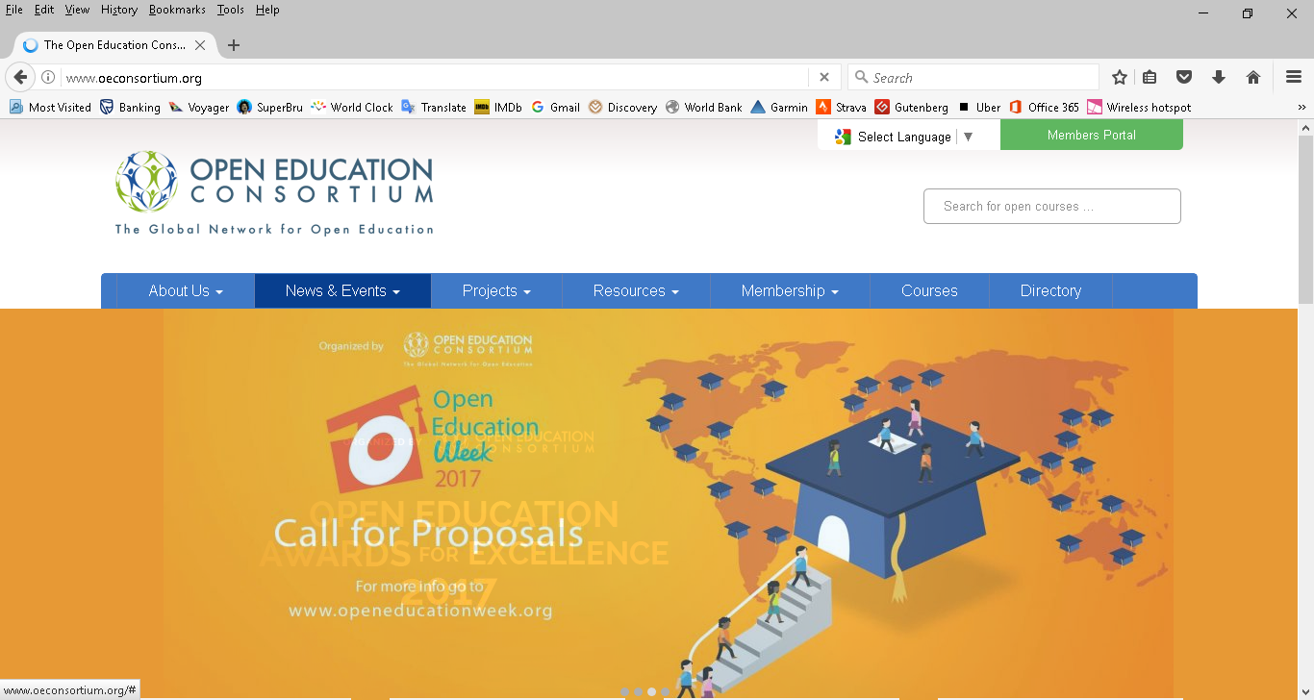

Slide 12
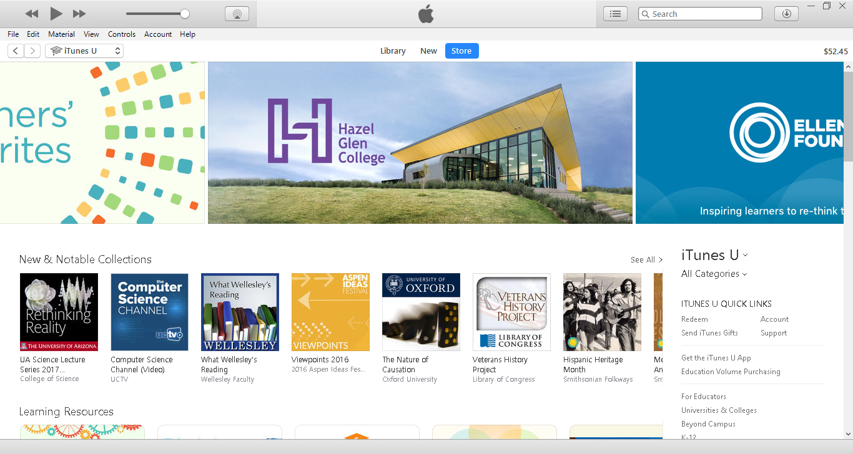

Slide 13
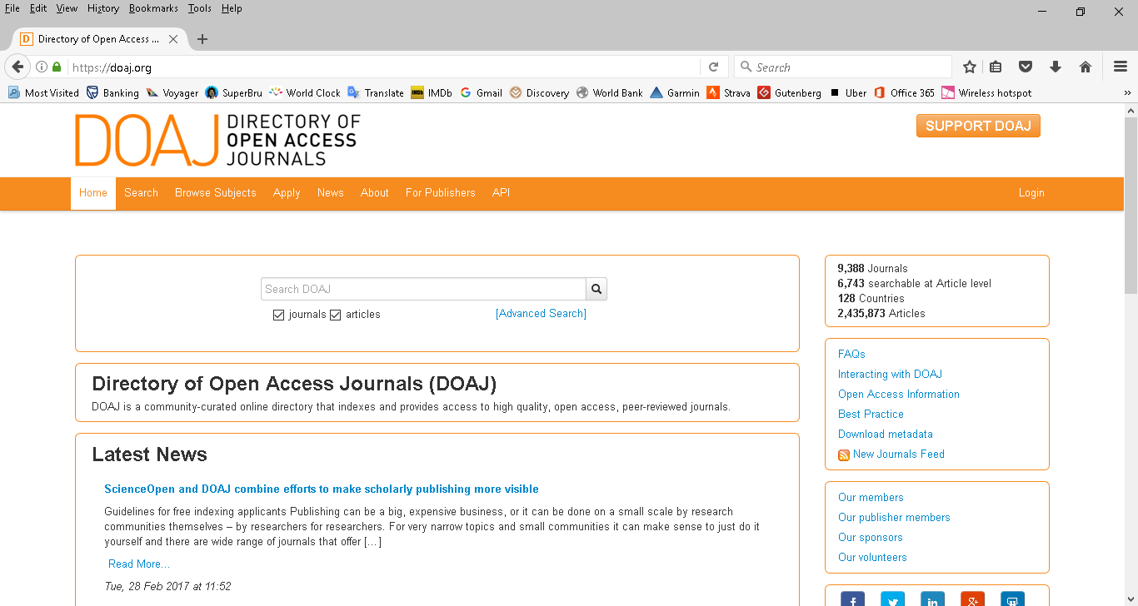

Slide 14
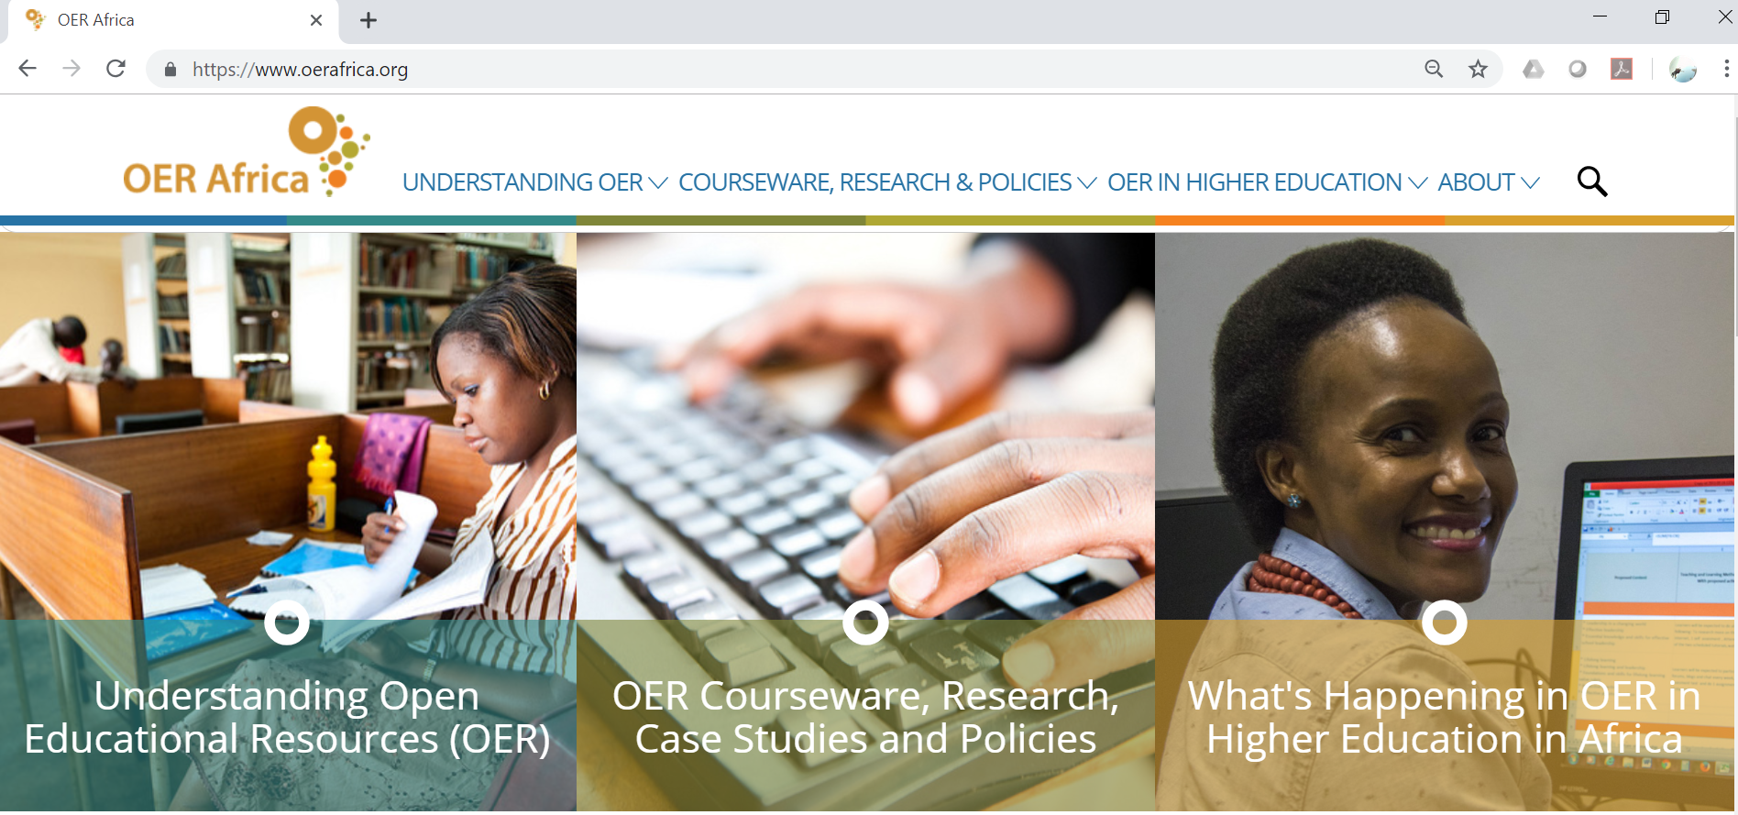

Slide 15
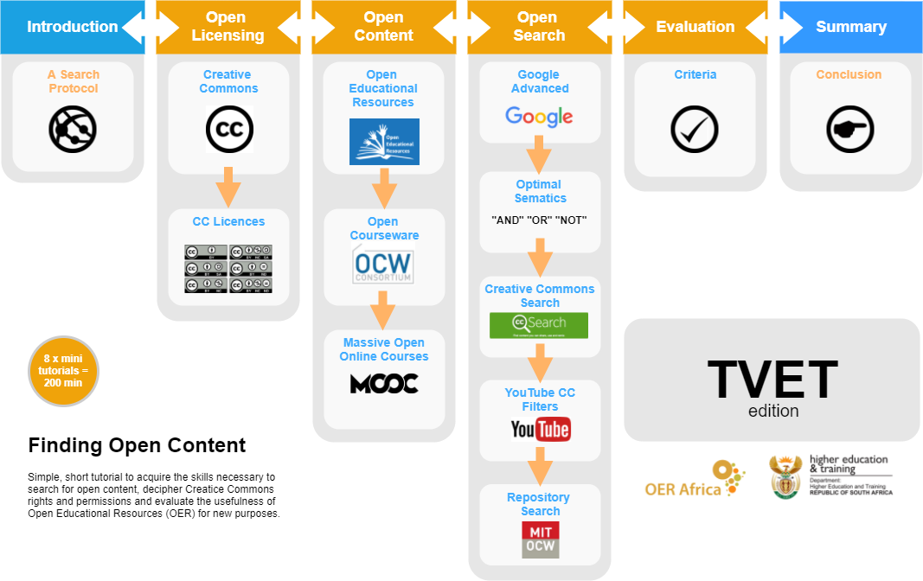
https://www.oerafrica.org/content/finding-open-content-new-oer-africa-resource

Slide 16
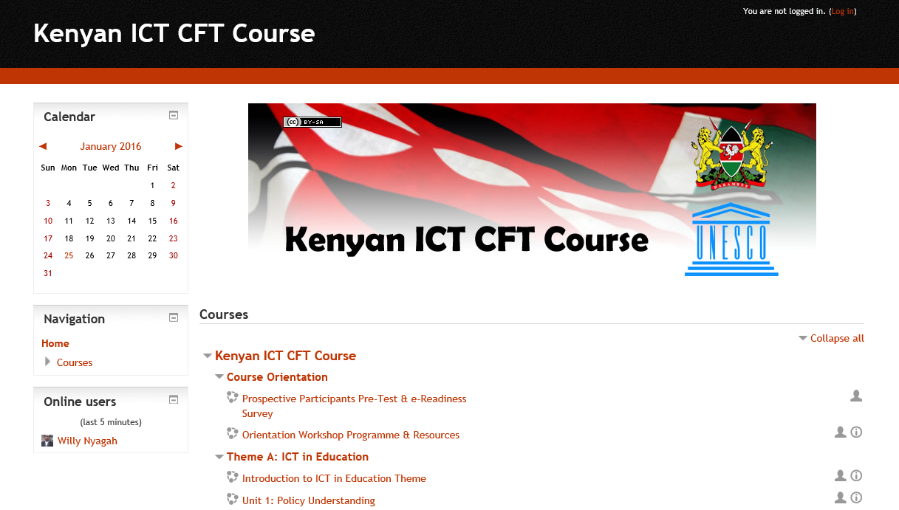
Putting it Into Practice – ICT CFT

Slide 17
Putting it Into Practice – KNUST, Ghana

Slide 18
Institutionalizing Openness
Investment in more effective teaching, learning, and research environments using resource-based learning
Embrace open licensing environments
Need to be accompanied by review and development of suitable institutional policies
Bandwidth and access have become essential

