Slide 1
Onderstepoort – OER Africa
Bosberaad Status Report 18 February 2016

Slide 2
Agenda
An overview of progress with AfriVIP and OER
A renewed sense of vision for these areas and how we can obtain greater management and personnel buy-in from the Faculty.
A better understanding of OER/Blended learning within the Faculty and their value, especially in respect of the teaching blocks for BVSc II
Some idea of the training that can be offered to increase confidence in blended learning/OER - e.g. a shortened workshop that was recently run.
A summary of the project to research the effectiveness of the block system.

Slide 3
Discussion Topics
Activity: Discussion / Plenary
What are OER?
What are their value proposition?

Slide 4
progress at OP with AfriVIP and OER

Slide 5
Background
Phase I: (2012-2014) OER Africa (with funding from William and Flora Hewlett Foundation) worked closely with Department of Veterinary Tropical Diseases to;
Conceive an education model that embraced technology and ‘openness’
Provide awareness of OER to staff within the wider faculty
Construct AfriVIP, an online repository of quality veterinary teaching and learning resources, as an initial mechanism to achieve the vision of a blended open learning environment.
By the end of phase I AfriVIP was launched (http://www.afrivip.org/) containing predominately CPD resources.
Phase II commenced in 2015 and will run to early 2017.

Slide 6
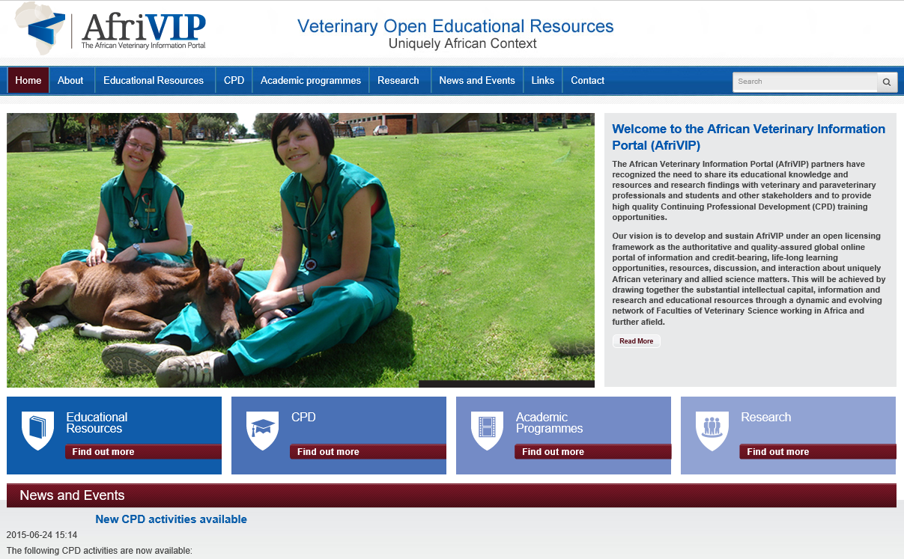

Slide 7
Phase II Original Vision
The intention of Phase II was to build on the progress made in the earlier phase, enlarge the resources offerings, grow the number of UP staff and students involved, but also research the impact of the initiatives in ‘transforming teaching and learning’. To achieve this the following three thrusts were envisaged:
Continue to build and expand the AfriVIP repository
Encourage staff and students, beyond the VTD Department, to adopt and contribute OER through advocacy and training.
Use AfriVIP to develop collaborative partners within the region.

Slide 8
Phase II Targets
All Continuing Professional Development (CPD) courses being offered by Onderstepoort will be developed using OER, with at least 5 new courses operational by the end of the grant.
The newly established AfriVIP Portal will be systematically integrated into the delivery of at least four different undergraduate and postgraduate programs at the Faculty, as a primary source of educational materials for these programs
A revised institutional policy on intellectual property will have been developed under the auspices of the Information Governance Committee, based on the lessons learned from the work at Onderstepoort
Planning engagements with at least one other Faculty at the University of Pretoria will have been concluded, with commitment from that Faculty for integration of OER into its educational activities
At least two other Faculties of Veterinary Sciences from Southern and/or Eastern Africa will be actively contributing resources to the development of the AfriVIP Portal.
A detailed collaborative project will have been successfully designed, incorporating at least 4-5 of the Faculties of Veterinary Science participating in the Regional Deans’ meeting

Slide 9
Phase II Strategy
Create a Faculty OER Management Team to co-ordinate initiatives.
Create a steering committee to provide an enhanced vision
Expand AfriVIP functionality
Automate the allocation of CPD points
Provide users with a CPD portfolio that creates a SAVC CPD report.
Encourage departmental and student contributions to AfriVIP
Use the requirement to move to block teaching to encourage blended learning and use of OER in numerous 2nd Year subjects.
Invite deans of regional faculties to Pretoria to conceive a collaborative project.
Prepare a draft OER policy/strategy document at conclusion of Phase II to inform UP management on how to adjust IP policy statements.

Slide 10
Progress Report
OER Working Group has been formed with representatives from each department and also library that convenes 4 times a year. (Minutes)
A workflow OER QA process has been designed.
Within departments various teaching resources have been identified and many have been loaded into the AfriVIP database, not as CPD but teaching resources
Two projects have commenced that target student contributions. Students were trained to use phones to document clinical procedures and experiences in the field.
Relationship with SAVA has been established and a trial of 20 CPD articles have been loaded into AfriVIP. The mechanism for allocating points is in process.
A functional specification has been developed by OER Africa for the portfolio module.
Meeting with 4 regional deans (Namibia, Zimbabwe, Edwardo Mondelane and Soikoine) took place during 2015 and a draft project proposal was developed. This was followed up by visits to Mozambique and Tanzania.

Slide 11
Progress: Regional Deans

Slide 12
Progress Report
Contact made with School of Health Systems and Public health and now potentially with Faculty of Education for initiaives and projects around OER.
Feb 2016. - A training programme was developed and deployed to support staff create open blended learning programmes that suit the block system.
A PAR research agenda has been developed that attempts to measure impact of blended open block teaching methods and UP/OP staff identified to coordinate the study

Slide 13
A renewed sense of vision & how we can obtain greater buy-in from the Faculty for AfriVIP?

Slide 14
Discussion Topics
Activity: Discussion / Plenary
What would we want in a renewed sense of OP’s OER vision?
How we can obtain greater buy-in from the Faculty, both management and educators, for AfriVIP?

Slide 15
understanding OER/Blended learning within the Faculty and their value particularly in respect to the teaching blocks for BVSc II

Slide 16
OER’s Role in Teaching & Learning
OER are not a solution in themselves. Educators can see them as a component of a solution to improve teaching and learning.
OER offers access to quality, free teaching and learning resources, the majority of which offer repurposing.
OER offer a platform to demonstrate quality education to those outside an institution.
Programmes can be developed quickly and cheaply using OER.
Repositories and sharing of OER provides an institution with a raised ‘profile’

Slide 17
Blended Learning
Research suggests that a mix of face to face interactions and access to digital technologies is the optimal learning approach.
Face to face interaction is excellent for skills transfer and deep understanding of concepts through discussion and debate. It is poor at content transmission.
Digital mediation is good at delivering content, administration tasks such as student tracking, keeping the learning community active when dispersed etc.
Some researches call for a flipped classroom method to effectively integrate these two modes.

Slide 18
Block Teaching
Block teaching has both pros and cons
Pros:
Concentrated focus on one topic rather than multiple strands running parallel allows for better understanding.
Sufficient time to allow students to practice skills and master skills.
Traditionally subjects tend to ‘steal’ time from other subjects by imposing assignments that require more time than they have been allocated.
Lecturers can’t lecture for a whole day and expect effective learning and are forced to use multitude of different teaching methods
Cons:
Blocks too short to allow consolidation of knowledge that occurs over time by returning to subject knowledge, say for examination purposes.

Slide 19
training Approaches to increase confidence in blended learning/OER

Slide 20
Discussion Topic
Activity: Discussion / Plenary
What training that can be offered to increase confidence in blended learning/OER/Block Teaching e.g. a shortened workshop that was recently run.
Existing Training Schedule

Slide 21
research Project to ascertain the effectiveness of the block system

Slide 22
Participatory Action Research
How do we know if the B. Vet Sci II block system is effective?
How do we know if blended learning is helping transform student learning practices?
Do OER really deliver on their promise of access to quality readymade teaching materials?
OER Africa is supporting OP ascertain impact by suggesting a proposed PAR Agenda
Proposed PAR OP OER Africa Research Agenda

Slide 23
Primary Research Question
What effect does the teaching system have on the long-term performance of students in the Bachelor of Veterinary Sciences programme?

Slide 24
Research Secondary Questions
What effect does the block teaching system have on short-term results? Is performance better or worse than previous years?
What effect does the block teaching system have on subsequent results beyond second year? Is performance better or worse than previous years?
How do teaching and learning methods and educational approaches change as a consequence of the introduction of block teaching?
Does the block teaching system lead to a sustained increase in the use of educational resources and teaching aids? Why? To what extent are lecturers harnessing OER as part of this increased resource use?

Slide 25
Secondary Research Questions
How do assessment practices change with the introduction of the block teaching system? What are the consequences – negative and positive – of this ?
What effect does the block teaching system have on lecturers? Does it demand more or less of their time? Does it lead to improved or diminished research output?
If more, why is this? And is this only in the short term due to introduction of the block teaching system or is it likely to be ongoing?
If less, where are the savings? And what are lecturers doing with the time saved?
What impact does the block teaching system have on programme management and administration? Do these associated overhead costs increase or decrease?

Slide 26
Research Secondary Questions
How are students’ lives affected by the block teaching system? Is it leading to any diminution in their social/campus life as students ?
What are the unintended consequences of implementation of the block teaching system?
Would this be + or – for the lecturer or the student or does it only refer to student performance? If only performance of students, will it only be the assessment practice in the block system that will determine whether it is positive or negative?
Would it be possible to determine this – it is the first year that the students come to OP (remember they do the 1st year at the Hatfield campus) What would it be measured against?

Slide 27
Research Team
Education Innovation Unit: El-Marie Mostert and Marius Piennar
Faculty of Veterinary Science: Dietmar(?) & others (?)
OER Africa: Neil Butcher & Andrew Moore

Slide 28
Thank You

