Slide 1
1
Webinar commences at 10h00 (UTC)
Emergency Remote Teaching
AAU / OER Africa webinar series W1 - Teach effectively during campus closure

Slide 2
Webinar rules and etiquette
Switch your video cam off, we want to preserve bandwidth.
Please mute your microphone, we don’t want background noise to interfere.
If you have a question, type it in the chat facility and the back-channel manager will respond, or pass on to the facilitator.
If asked to respond verbally the facilitator will mention you by name. Remember then, to turn off mute before speaking.
2 and 4
3
1

Slide 3
AAU welcome address
Nodumo Dhlamini
Director - ICT Services & Knowledge Management - AAU
ERT webinar
Neil Butcher
Education specialist and back channel manager – OER Africa
04
03

Slide 4
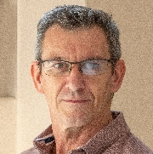
Today’s team
Nodumo Dhlamini
Andrew Moore
Director - ICT Services & Knowledge Management - AAU
Education specialist and webinar facilitator – OER Africa
ERT webinar
Neil Butcher
Monge Tlaka
Education specialist and back channel manager – OER Africa
Waiting off stage
04
03

Slide 5
ERT webinar series
Teach effectively during campus closure.
Tips and tricks: Media in PowerPoint
(Today!)
Aim: Guide academics to quickly and cheaply, adopt an emergency remote teaching strategy that enables student learning to continue?
1
Communicate effectively during campus closure.
Tips and tricks: Social media groups
(Friday 8th May)
2
4
3
What to teach during campus closure.
Tips and tricks: Google classroom
(Thu 30th April)
Know if learning is happening during campus closure.
Tips and tricks: Quizziz assessment tool
(Mon 4th May)

Slide 6
Webinar 1 agenda ERT essential elements
4. Provide feedback and support
1. Careful selection of materials
ERT
ESSENTIALS
3. Create student activities
2. Provide context for study
+ tips and tricks

Slide 7
Webinar 1 agenda Tips and tricks: media for presentations
1
2
Insert free open graphics
Insert free open YouTube videos
3
4
Insert your own voice
Insert screen capture

Slide 8
Webinar 1 resources
W1
Teach effectively during campus closure
W1 Resources
Access the webinar resources in our Google classroom:
https://classroom.google.com/
code m7p5bd5

Slide 9
Essential elements of ERT
4. Provide feedback and support
1. Careful selection of materials
ERT
ESSENTIALS
3. Create student activities
2. Provide context for study

Slide 10
Element 1: Selection of materials
Its important to carefully select content, and possibly edit materials, to ensure students are not overwhelmed, remain focused and stay motivated.
Distribute only essential content
Materials concise and/or ‘chunked’
Resources in multiple formats
Materials should have no barriers to access

Slide 11
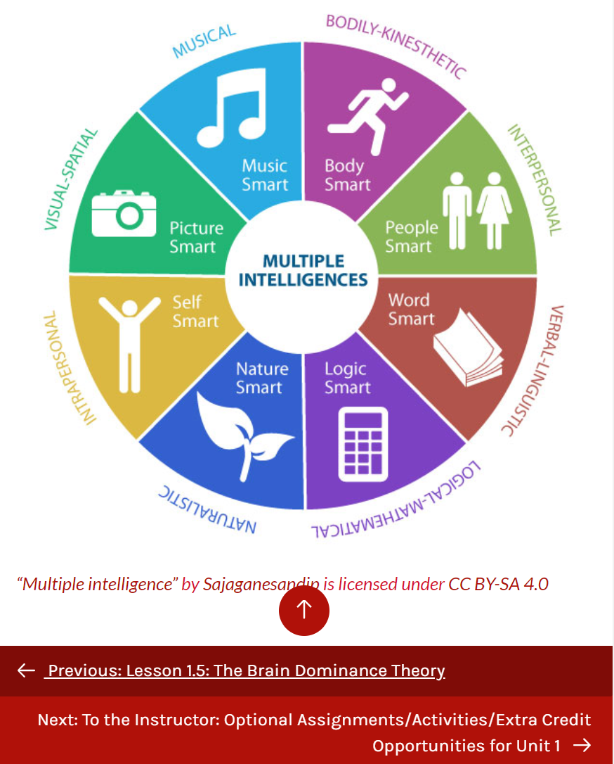
Some open resources
3
2
Tutorial to acquire the skills necessary to search for open content and decipher Creative Commons rights and permissions.
Helen Linda discusses the process of chunking content and drafting a script as a part of the Content Creation Module.
Overview of Gardener’s Multiple Intelligences Theory with diagram and exercises.
Access
Access
Access

Slide 12
Consider…
In what ways do you need to adjust the materials you have used previously?
AAU & OER Africa
Use either the Zoom chat facility or the Google Classroom discussion forum to tell us what your response is to the above query

Slide 13
Need more detail and/or skill?
Participate in ERT webinar 2
W2
2
We will investigate how to select specific parts of the curriculum suited to ERT and
then how to identify resources, edit them and choose digital tools to support remote teaching
What to teach during campus closure

Slide 14
Essential elements of ERT
4. Provide feedback and support
1. Careful selection of materials
ERT
ESSENTIALS
3. Create student activities
2. Provide context for study

Slide 15
Element 2: Provide context
Learning without a context is difficult. Learning happens when students understand new information in relation to what they already know or how it relates to prior experience.
?
Set
questions to focus study
Use real world problems to frame theory
Provide a hook
Students transfer theory to new contexts

Slide 16
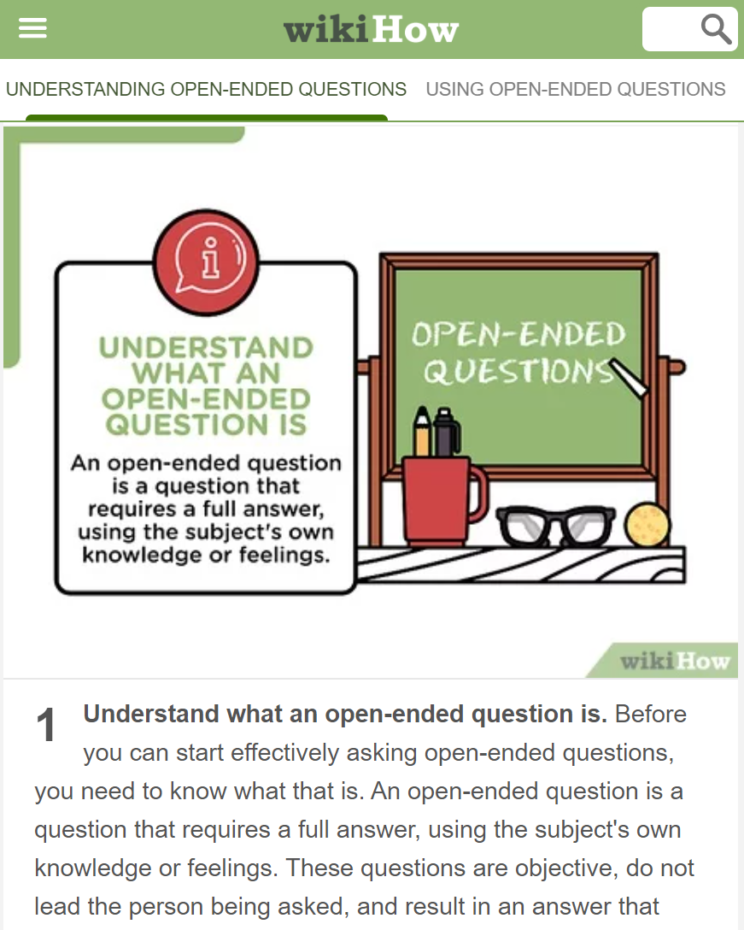
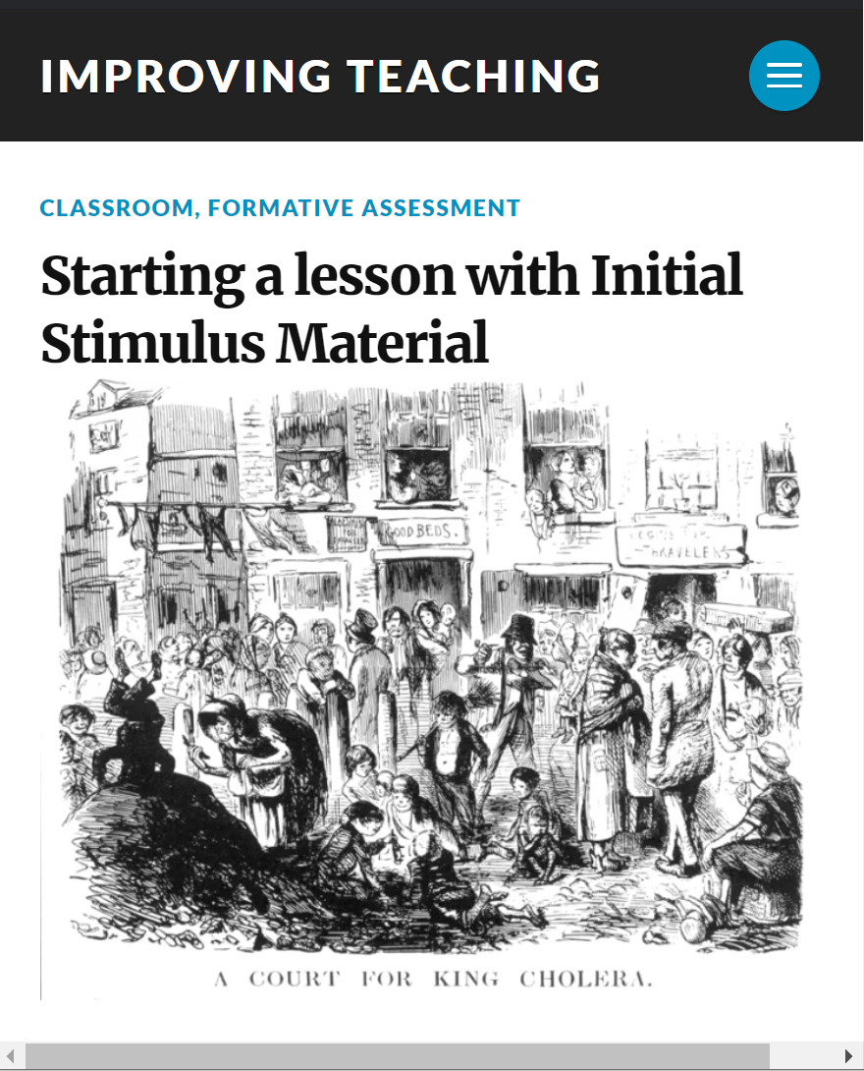
Some open resources
3
2
Asking questions is a basic way to gather information. Like everything else, there is a skill to it. Asking open-ended questions is a…
This film examines the critical role of curiosity and engagement for today's youth and in connected learning
Strategies to provide a hook or stimulus to hang a lesson on and create student engagement.
Access
Access
Access

Slide 17
Essential elements of ERT
4. Provide feedback and support
1. Careful selection of materials
ERT
ESSENTIALS
3. Create student activities
2. Provide context for study

Slide 18
Element 3: Set student activities
Student should be required to do something with the materials beyond simple recall/comprehension. ERT activities might include,
Online debates or discussions
Short focused assignments
Project work covering multiple lessons
Short quiz or tests

Slide 19
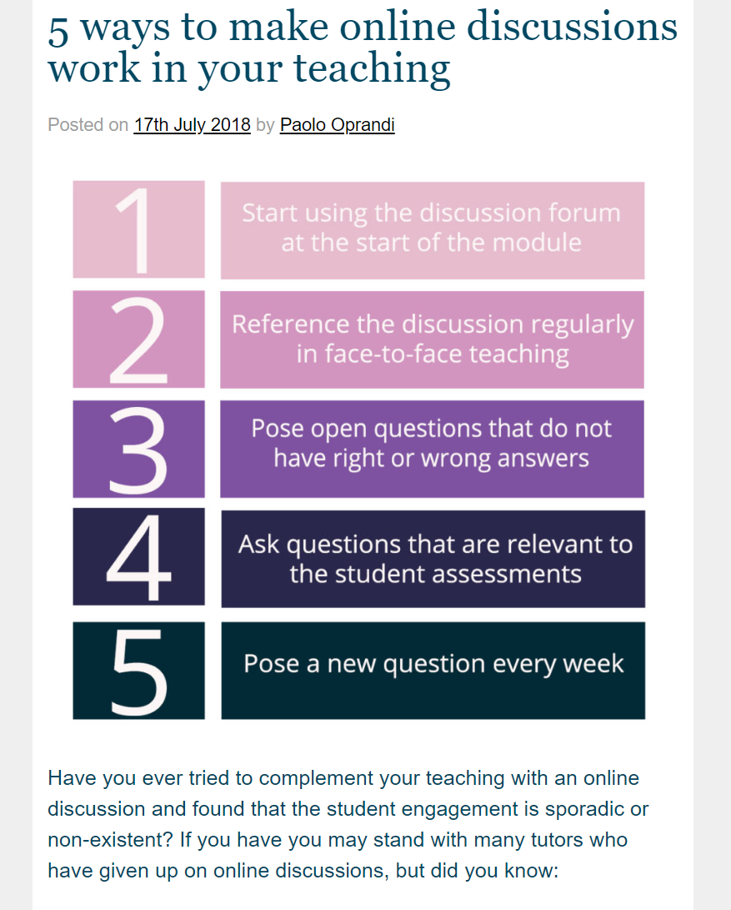
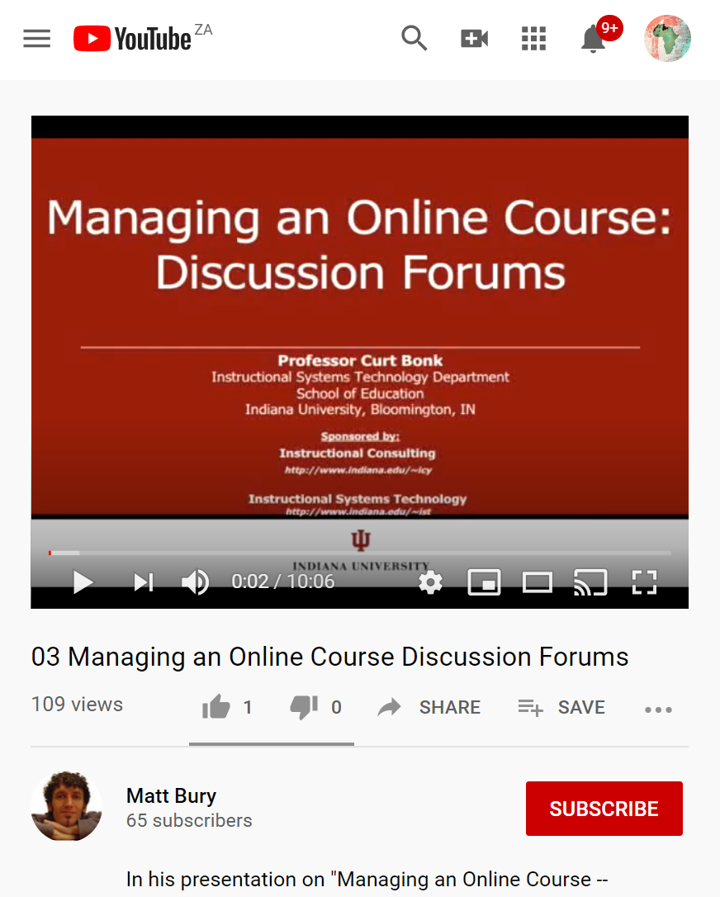
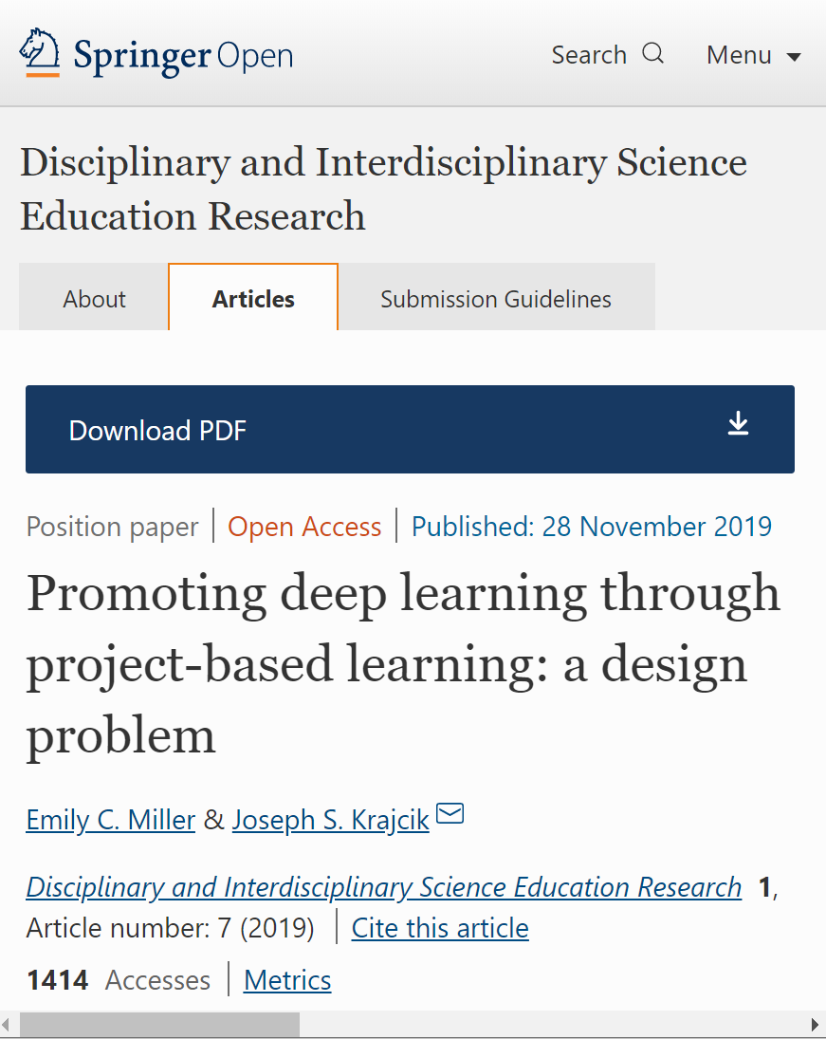
Some open resources
3
2
5 ways to make online discussions work in your teaching
Addresses the importance of discussion forums and managing them successfully. Points covered range from developing protocols and …
Promoting deep learning through project-based learning: a design solution that involves the bringing together of PBL …
Access
Access
Access

Slide 20
Need more detail and/or skill?
Participate in ERT webinar 3
W3
3
We will investigate how to set activities assignments and tests and use them to track student growth and learning.
Know if learning is happening

Slide 21
Essential elements of ERT
4. Provide feedback and support
1. Careful selection of materials
ERT
ESSENTIALS
3. Create student activities
2. Provide context for study

Slide 22
Element 4: Provide feedback
Its important that students don't feel isolated or lost during ERT. You need to have an online presence and demonstrate that you are engaging with them and their tasks even though they are studying remotely.
FAQ
Weekly ‘office hours’ video
Encourage use of peer networks
FAQ
Summarize readings

Slide 23
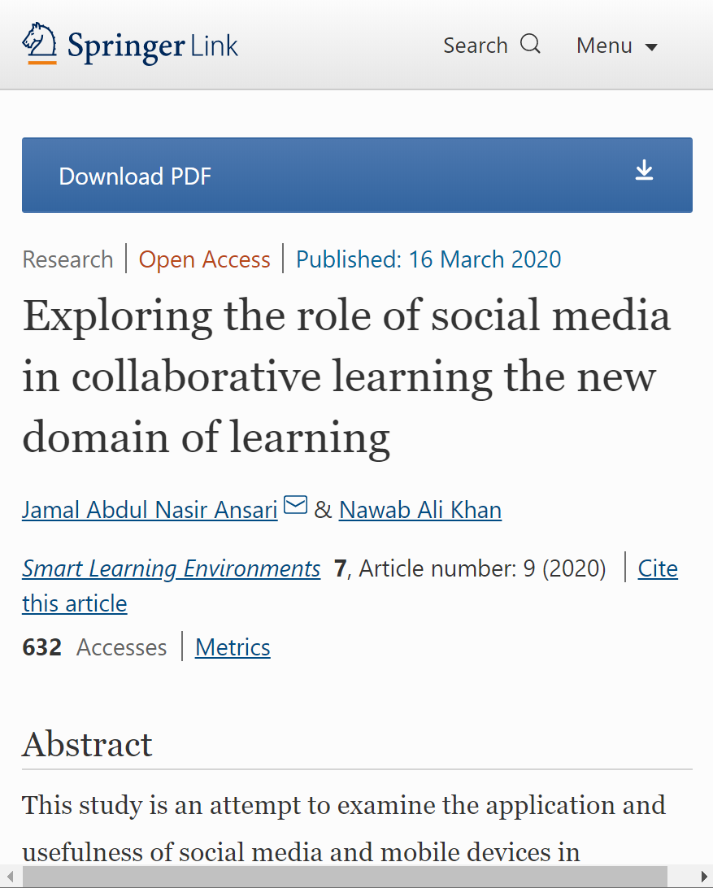
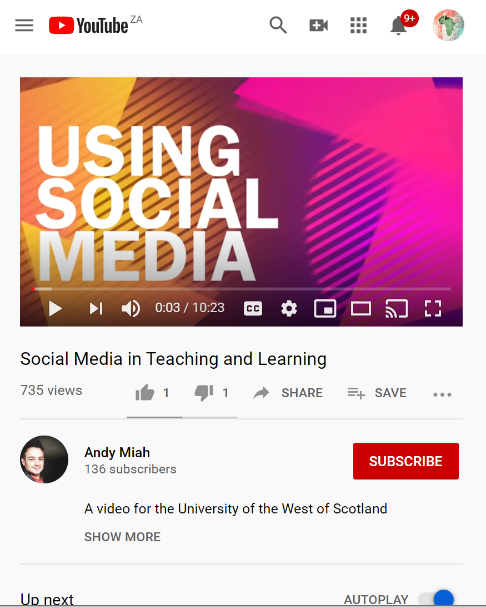
Some open resources
3
2
Create a compelling welcome video to let your students get to know you.
Andy Miah, University of West Scotland, discusses the pros and cons of using social media in higher education.
Examine the application and usefulness of social media and mobile devices in transferring the resources and interaction with academicians in HE institutions
Access
Access
Access

Slide 24
Consider…
What communication tools can you deploy immediately?
AAU & OER Africa
Use either the Zoom chat facility or the Google Classroom discussion forum to tell us what your response is to the above query

Slide 25
Need more detail and/or skill?
Participate in ERT webinar 4
W4
4
We will investigate strategies to effectively support and communicate with the students as well as protect yourself and faculty from burnout.
Communicate effectively during campus closure

Slide 26
Demonstration
How to make study materials engaging and easier to understand using popular software

Slide 27
Demonstration: tips and tricks
1
2
Insert free open graphics
Insert free open YouTube videos
3
4
Insert your own voice
Insert screen capture

Slide 28
1
Click the image to start the video.

Slide 29
Queries?
Any questions?
AAU & OER Africa
Use either the Zoom chat facility or the Google Classroom discussion forum to tell us what your response is to the above query

Slide 30
2
Click the image to start the video

Slide 31
Queries?
Any questions?
AAU & OER Africa
Use either the Zoom chat facility or the Google Classroom discussion forum to tell us what your response is to the above query

Slide 32
3
Click the image to start the video

Slide 33
Queries?
Any questions?
AAU & OER Africa
Use either the Zoom chat facility or the Google Classroom discussion forum to tell us what your response is to the above query

Slide 34
4
Click the image to start the video

Slide 35
Queries?
Any questions?
AAU & OER Africa
Use either the Zoom chat facility or the Google Classroom discussion forum to tell us what your response is to the above query

Slide 36
Webinar 1 – Summary ERT essential elements
4. Provide feedback and support
1. Careful selection of materials
ERT
ESSENTIALS
3. Create student activities
2. Provide context for study

Slide 37
Webinar 1 resources
W1
Teach effectively during campus closure
W1 Resources
Access the webinar resources in our Google classroom:
https://classroom.google.com/
code m7p5bd5
Including this presentation and tips and tricks videos

