Slide 1
4
Webinar commences at 10h00 (UTC)
10h00 – Ghana
11h00 – Nigeria and Cameroon
12h00 – South Africa and Egypt
13h00 - Kenya
Emergency Remote Teaching
AAU / OER Africa webinar series W4 – How to communicate effectively during campus closure

Slide 2
Webinar rules and etiquette
Note: Your microphone has been automatically turned OFF. Please leave it off.
Note: Your video cam has been automatically turned OFF, we want to preserve bandwidth.
If you have a question, type it in the chat facility and the back-channel manager will respond, or pass on to the facilitator.
If for unforeseen issues we have to close the chat please e-mail queries to the back-channel manager: neilshel@nba.co.za
2
3
1

Slide 3
AAU messages
Nodumo Dhlamini
Director - ICT Services & Knowledge Management - AAU
ERT webinar
series
04
03

Slide 4
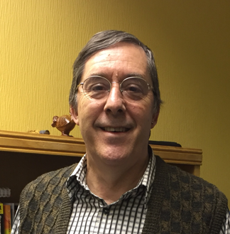
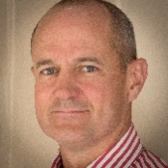
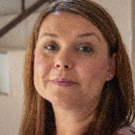
Today’s team
Nodumo Dhlamini
Tony Lelliott
Director - ICT Services & Knowledge Management - AAU
Education specialist and webinar facilitator – OER Africa
ERT webinar
series
Neil Butcher
Cathy MacDonald
Co-project director and back channel manager – OER Africa
Assistant back channel manager – OER Africa
04
03

Slide 5
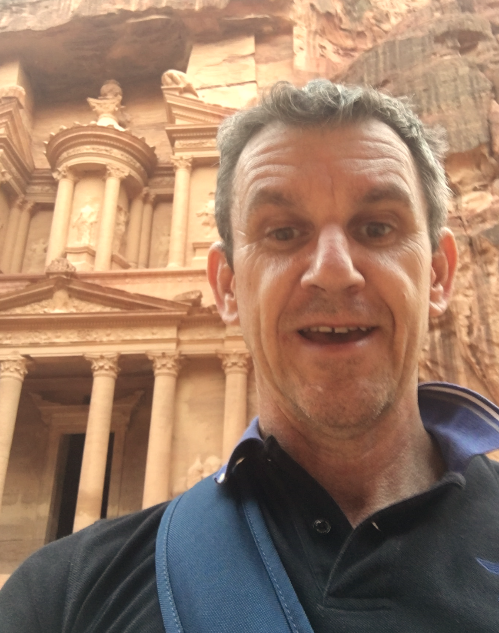
Your facilitator
Access
Andrew Moore
Director - ICT Services & Knowledge Management - AAU
Andrew Moore
Access
Education specialist – OER Africa
ERT webinar series
Access
04
03
Access

Slide 6
ERT webinar series
Teach effectively during campus closure.
Tips and tricks: Media in PowerPoint
(Complete)
Aim: Guide academics to quickly and cheaply, adopt an emergency remote teaching strategy that enables student learning to continue?
1
Communicate effectively during campus closure.
Tips and tricks: Social media groups
(Friday 8th May)
2
4
3
What to teach during campus closure.
Tips and tricks: Google classroom
(Complete)
Know if learning is happening during campus closure.
Tips and tricks: Quizziz assessment tool
(Complete)

Slide 7
Webinar 4 – Agenda Communicate effectively during campus closure
4. Synchronous meeting tips
1. Devise a communication strategy for ERT
2. Effective communication practice
3. ERT digital communication tools
+ tips and tricks

Slide 8
Demonstration: tips and tricks
1
2
Create a WhatsApp Group for your course
Create a Facebook
Page for your course
Add students to the class

Slide 9
Webinar 4 resources
W4
Resources
Access the webinar resources in our Google classroom:
https://classroom.google.com/
code m7p5bd5
Resources
Access resources on OER Africa:
https://www.oerafrica.org/aau-oer-africa-emergency-remote-teaching-webinar-series
Communicate effectively during campus closure?

Slide 10
Communication strategy
4. Synchronous meeting tips
1. Devise a communication strategy for ERT
2. Effective communication practice
3. ERT digital communication tools

Slide 11
Communication strategy
Plan ‘when’ and ‘how’ you and faculty will keep in contact with students during ERT?
Plan and strategize
Clear contact and availability information
Synchronous and asynchronous opportunities
Plan regular, creative announcements

Slide 12
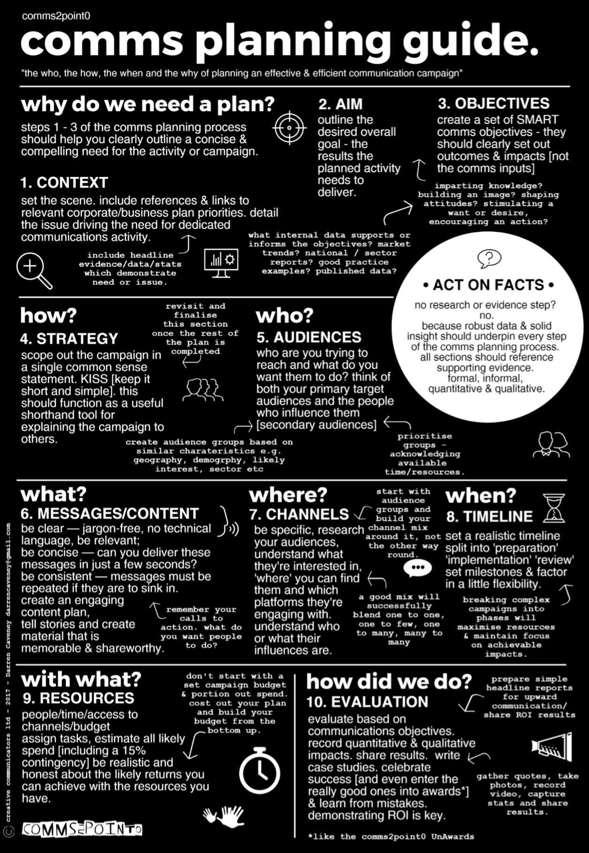
Fully copyrighted but free to use and share:
https://comms2point0.co.uk/resources/2017/8/1/your-essential-comms-planning-guide

Slide 13
Fully copyrighted but free to use and share:
https://comms2point0.co.uk/resources/2017/8/1/your-essential-comms-planning-guide

Slide 14
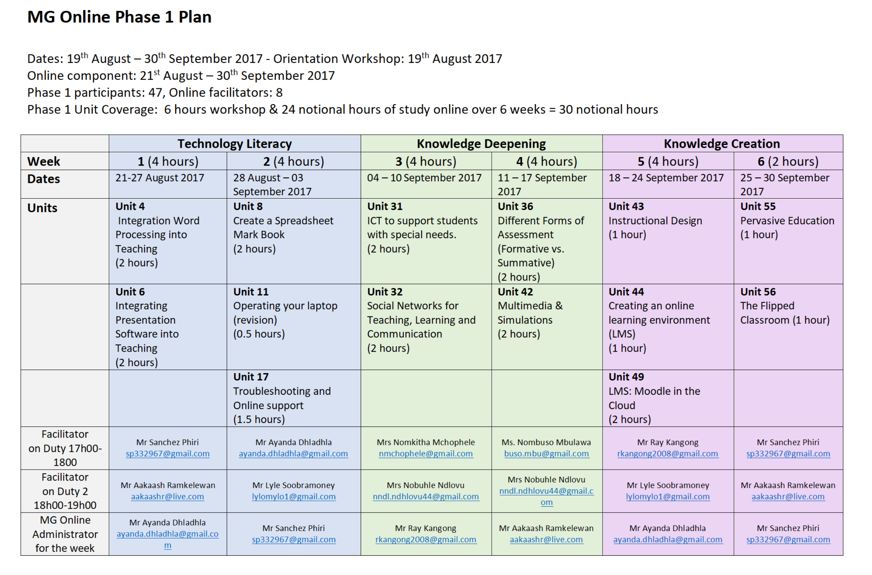
Communication strategy
Office hours duty roster

Slide 15
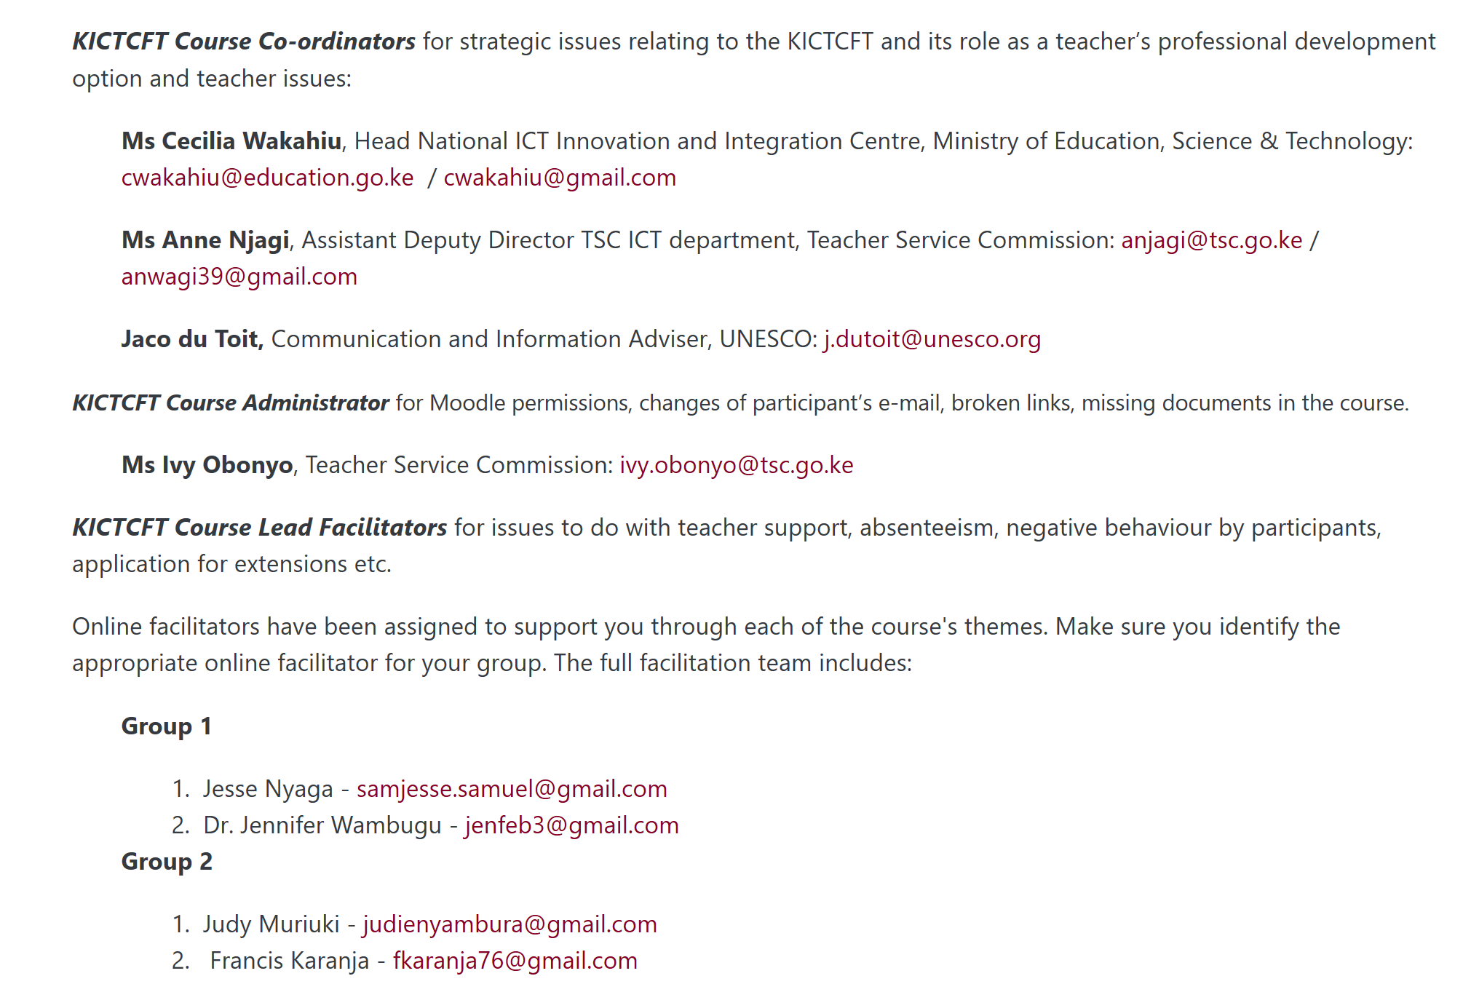
Communication strategy
Academic assistance
Technical assistance
Tutors

Slide 16
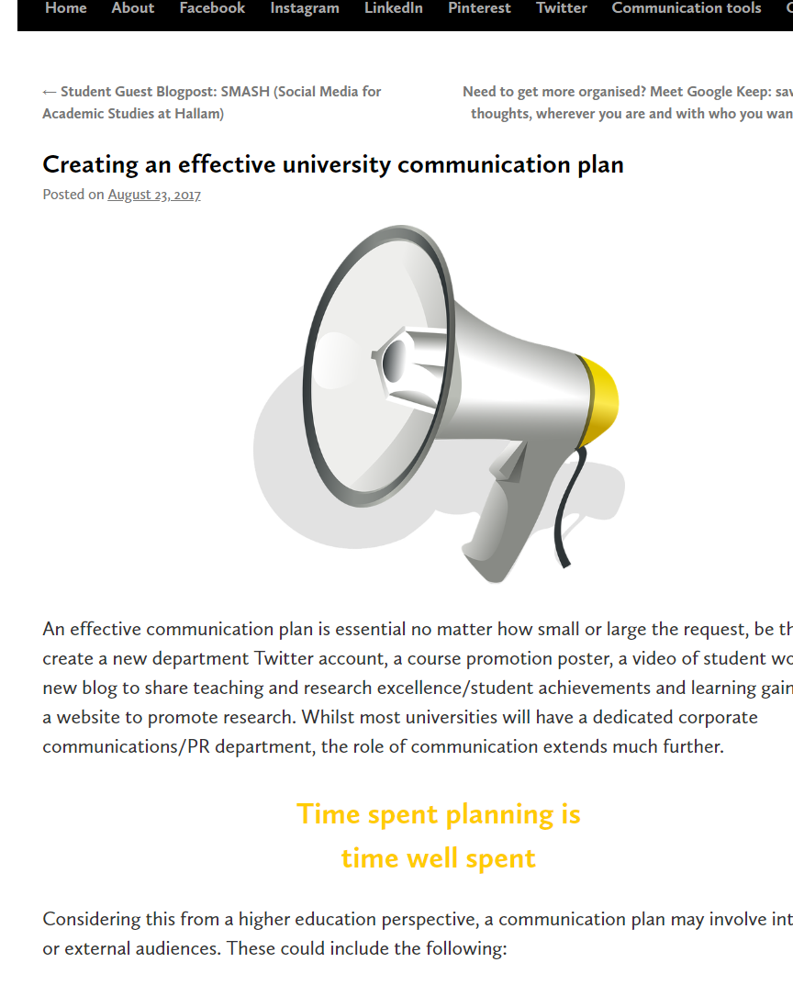
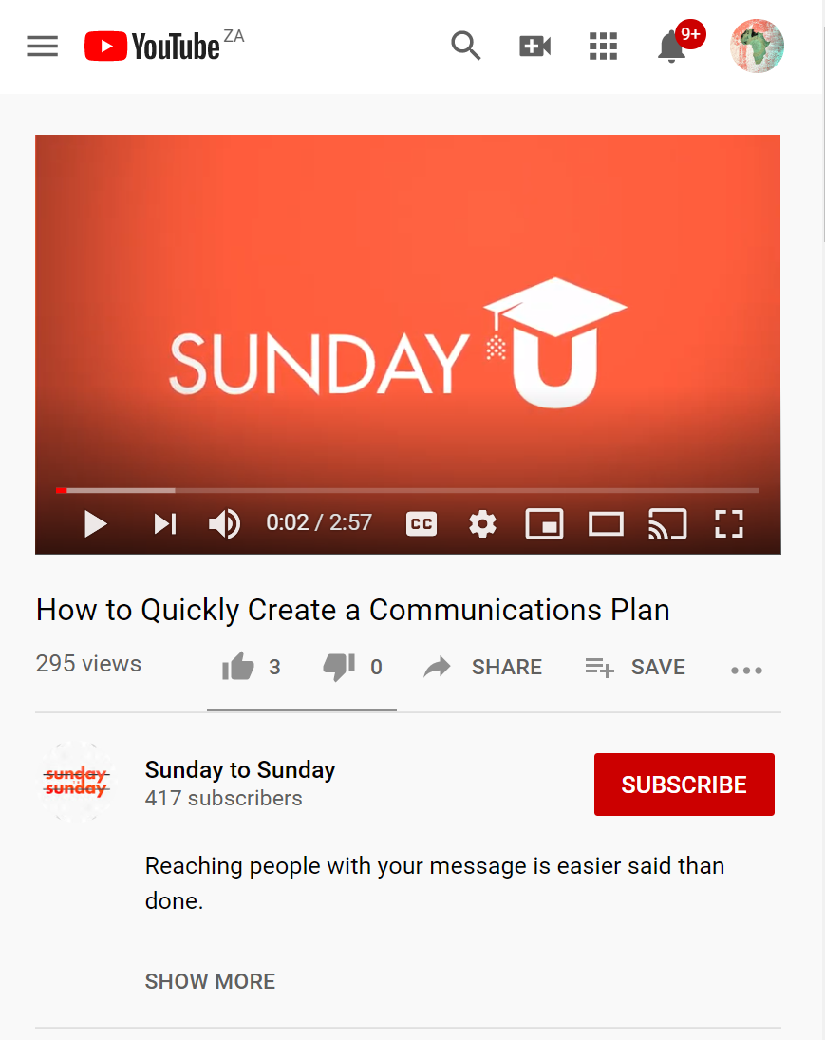
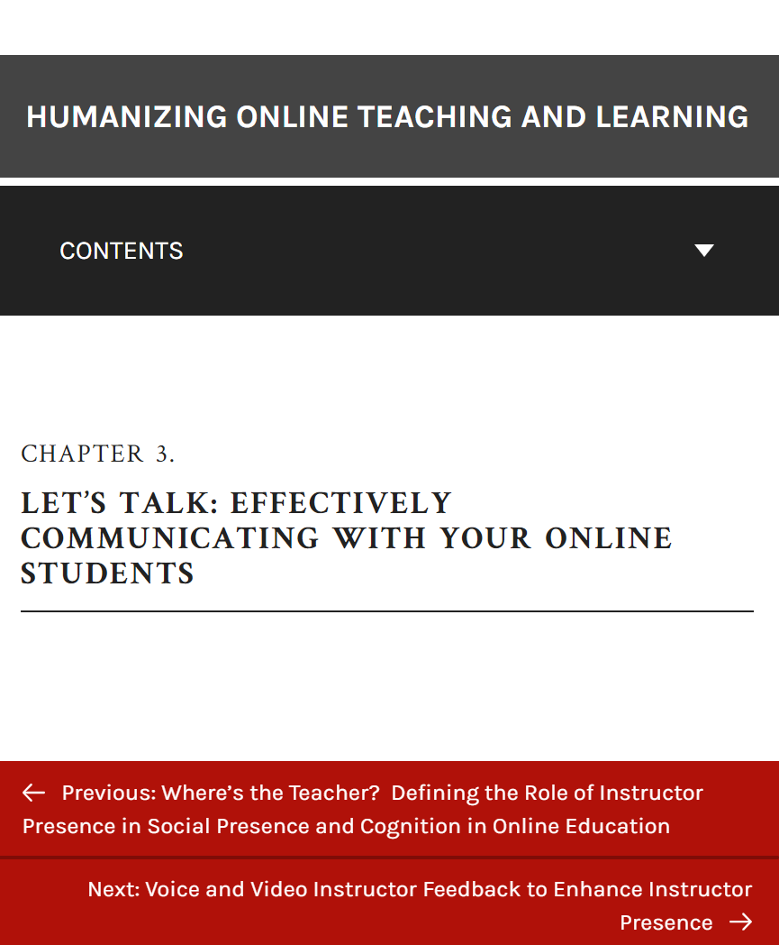
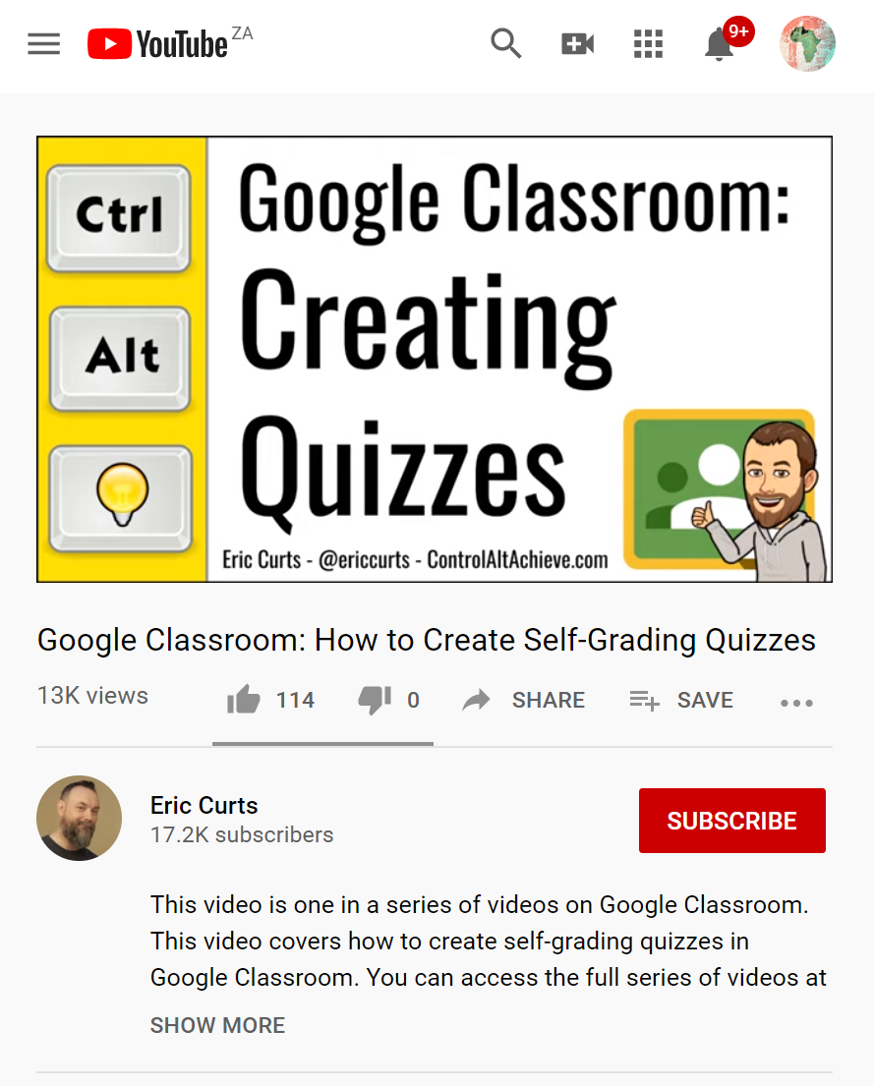
Some open resources
3
2
Social Media for Learning by Sue Beckingham looks at creating and effective university communication plan
Aimed at church communication but contains ideas to create and effective communication strategy.
Humanizing Online Teaching and Learning by Whitney Kilgore
Access
Access
Access

Slide 17
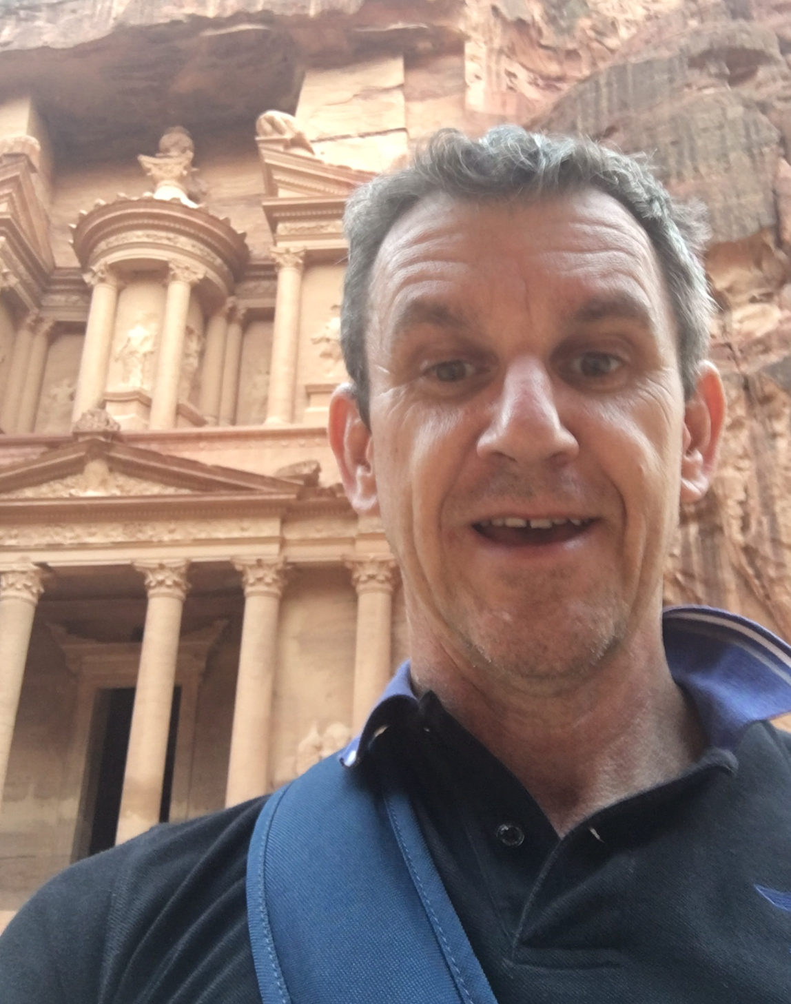
Consider…
What are your faculties experiences of student needs in the first part of national lockdowns and campus closures? Do you feel you have put effective methods in place to ‘protect’ faculty?
AAU & OER Africa
Use either the Zoom chat facility or the Google Classroom discussion forum to tell us what your response is to the above query

Slide 18
Communication practice
4. Synchronous meeting tips
1. Devise a communication strategy for ERT
2. Effective communication practice
3. ERT digital communication tools

Slide 19
Communication practice
What should you do to make communications / communiques engaging and effective?
Be involved, active in discussions
Provide personal, meaningful feedback
Send regular, engaging announcements
Content: Less is more, clear and concise

Slide 20
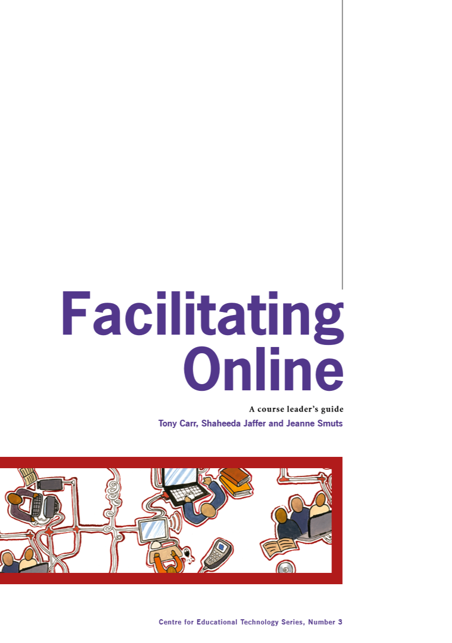
Communication practice
Do not write Looooong emails
Do not give very short answers (‘yes’, ‘no’, ‘rubbish’, etc.)
Do not give very long answers (‘bla…bla…bla’)
Do not forget to answer mails,
When answering email don't be overly critical
Do not forget to set deadlines, define tasks and goals
Do not forget to define the roles of each member
Do not give people very strict, long or complicated guidelines
Do not promise outputs/contributions and fail to deliver

Slide 21
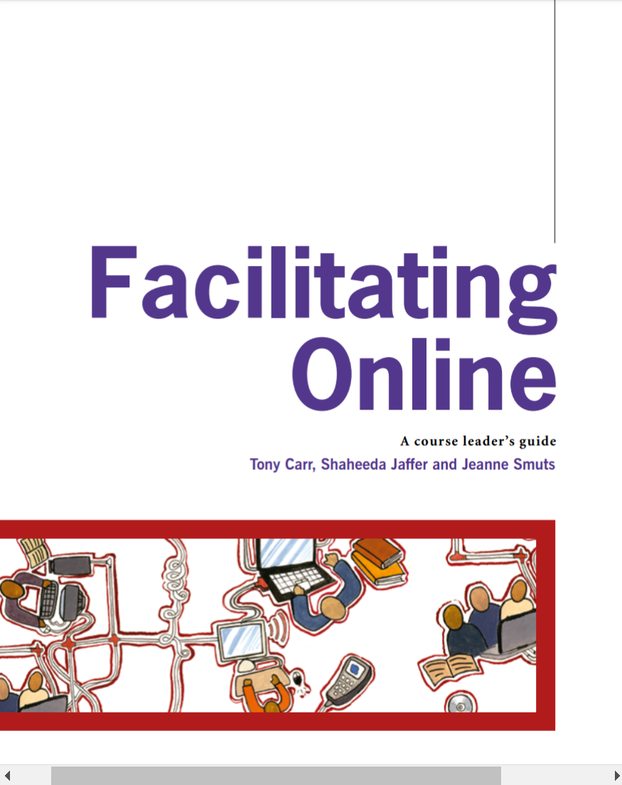
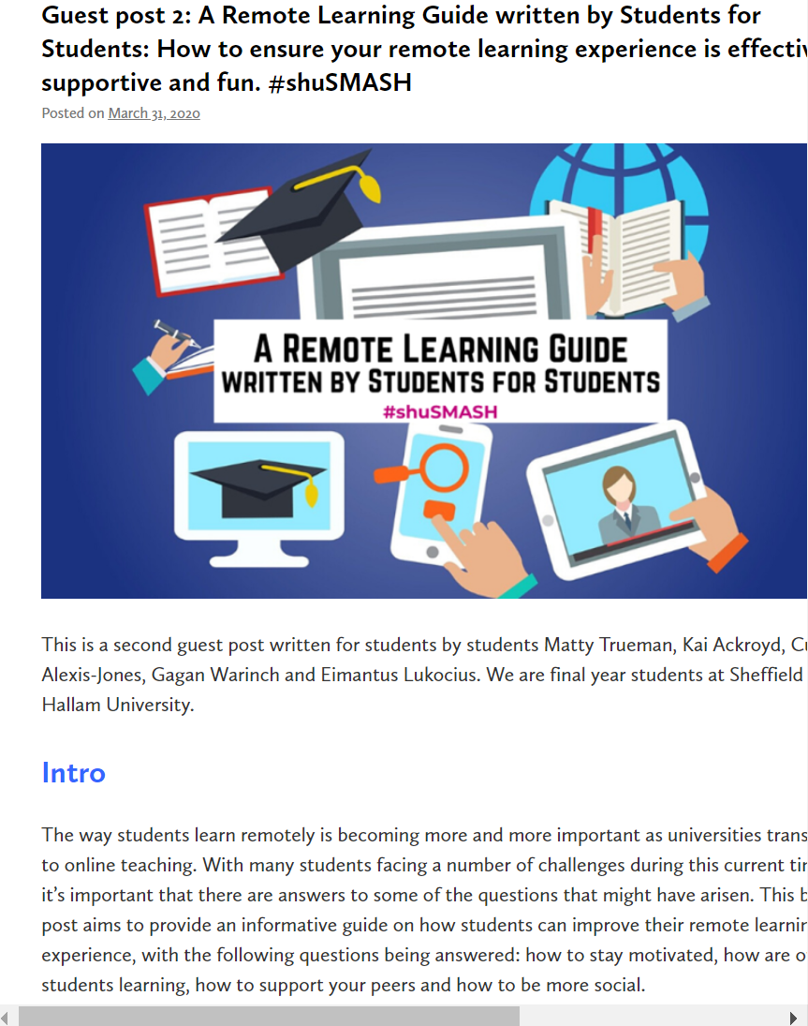
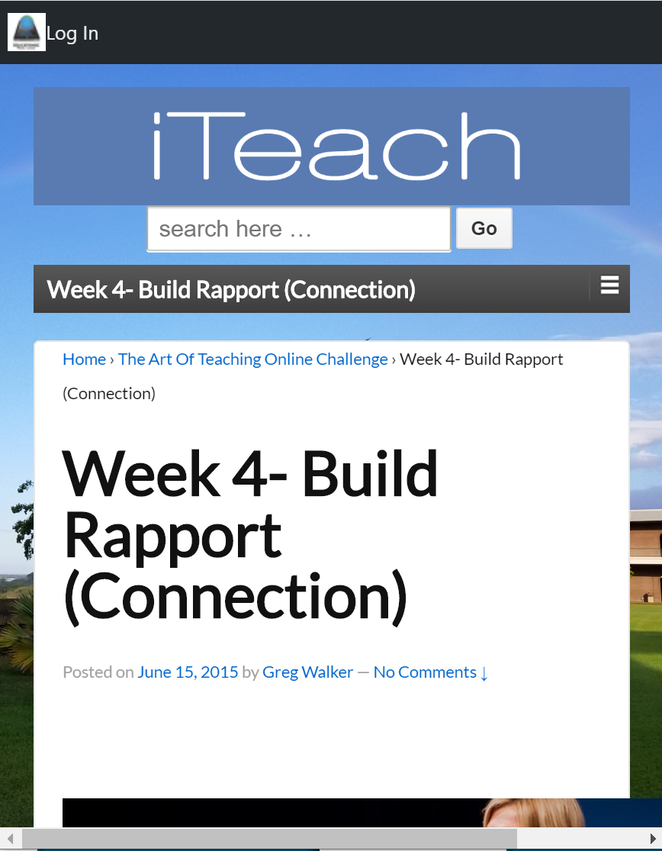
Some open resources
3
2
UCT CILT manual on online facilitation.
Student remote learning resource kit including communication protocols in Sue Beckingham’s blog
iTeach has a great article on how to build rapport with remote students via communication.
Access
Access
Access

Slide 22
Consider…
Less is more? Are your communiques clear and concise?
AAU & OER Africa
Use either the Zoom chat facility or the Google Classroom discussion forum to tell us what your response is to the above query

Slide 23
Communication tools
4. Synchronous meeting tips
1. Devise a communication strategy for ERT
2. Effective communication practice
3. ERT digital communication tools

Slide 24
Communication tools
What tools are available for ERT communication?
LMS communication tools
Traditional:
Phone, mobile and e-mail
Social media platforms
Synchronous online team meetings

Slide 25
Consider…
What options are best for low bandwidth learning environments?
AAU & OER Africa
Use either the Zoom chat facility or the Google Classroom discussion forum to tell us what your response is to the above query

Slide 26
Synchronous tips
4. Synchronous meeting tips
1. Devise a communication strategy for ERT
2. Effective communication practice
3. ERT digital communication tools

Slide 27
Synchronous tips
What is good practice when engaging with students in synchronous team meeting platforms?
Team approach to running meetings
Clear and well communicated scheduling
Carefully structured but not overly designed
Encourage a two-way online engagement

Slide 28
Synchronous tips
Tips
Don’t do ‘synchronous’ what can be done ‘asynchronously’.
Devise a check-in activity to allow participants to share prior experiences/knowledge.
Be structured but not overly designed – leave ‘spaces’.
Video cam on if possible
Chunk the program into 5 minute segments – attention spans are smaller online.
Break the session into interactive engagements
Note that retention is 50% less than face-to-face engagements.
Fogelberg, F & Tavanyar, J (2015). Live Connections. Pub Nomadicibp. ©

Slide 29
Synchronous tips
Commandments
Play to the strengths of online environments
Create interactivity
Create an engaging online environment
Address the social aspect
Provide structure and clarity
Apply a virtual etiquette
Keep it short or include energy breaks
Use virtual breakout groups
Use images over words
Provide opportunities for practice
Fogelberg, F & Tavanyar, J (2015). Live Connections. Pub Nomadicibp. ©

Slide 30
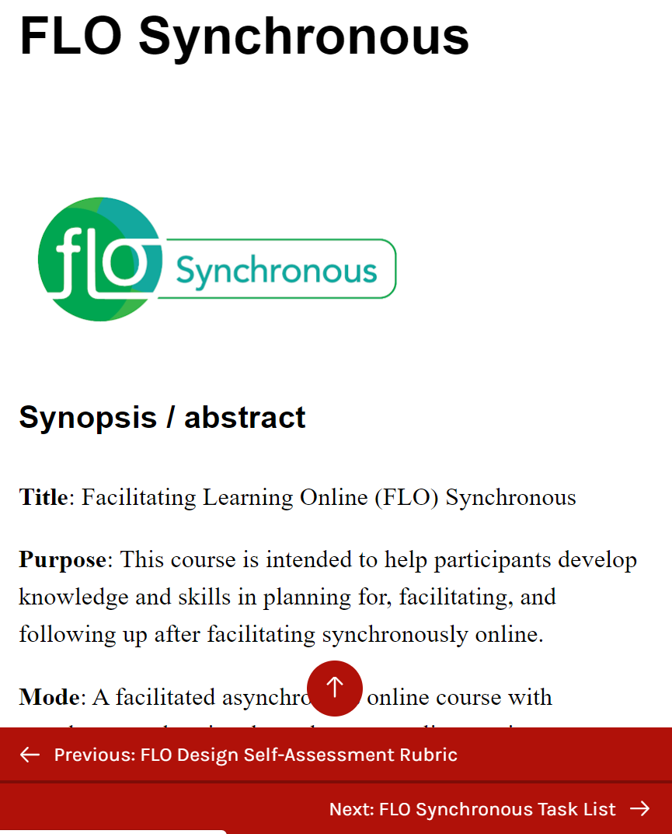
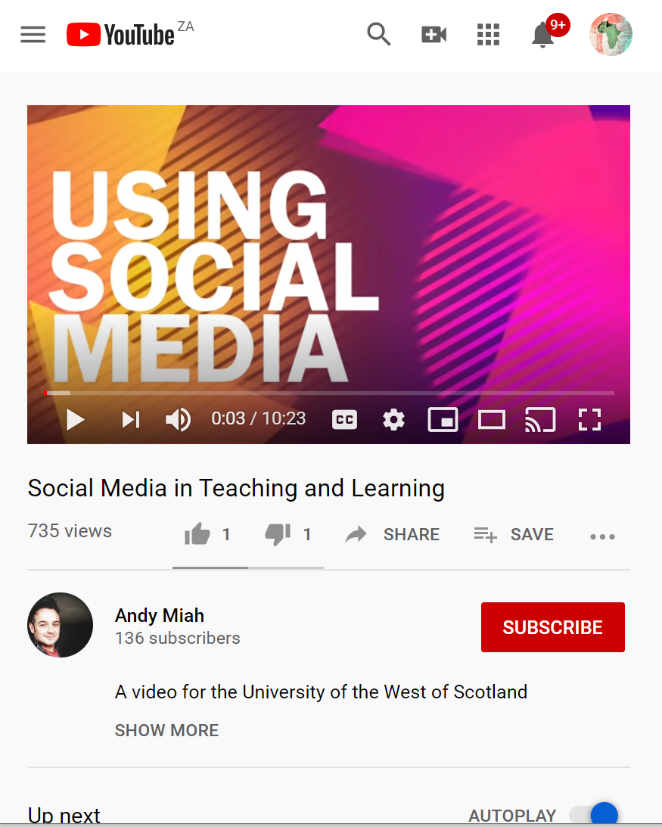
Some open resources
3
2
BC Campus course materials on FLO synchronous facilitation
Free to access as ‘Guest’ a self study course on FLO by Royal Roads University
2017 Open Access article on using synchronous online tools to support mathematics learning
Access
Access
Access

Slide 31
Consider…
To what extent did the designers of this webinar series implement the Live Connections commandments?
AAU & OER Africa
Use either the Zoom chat facility or the Google Classroom discussion forum to tell us what your response is to the above query

Slide 32
Demonstration
How to set up your own WhatsApp Group for your course

Slide 33
1
Course WhatsApp Group
https://youtu.be/u7_S-fr2_Ug

Slide 34
Queries?
Any questions?
AAU & OER Africa
Use either the Zoom chat facility or the Google Classroom discussion forum to tell us what your response is to the above query

Slide 35
Demonstration
How to set up your own Facebook Page for your course

Slide 36
2
Course Facebook
Page
https://www.youtube.com/watch?v=PwYSve54dU0

Slide 37
Queries?
Any questions?
AAU & OER Africa
Use either the Zoom chat facility or the Google Classroom discussion forum to tell us what your response is to the above query

Slide 38
Webinar 4 – Summary Communicate effectively during campus closure
4. Synchronous meeting tips
1. Devise a communication strategy for ERT
2. Effective communication practice
3. ERT digital communication tools
+ tips and tricks

Slide 39
Webinar 4 resources
Communicate effectively during campus closure
All webinar resources
Access the webinar resources in our Google classroom:
https://classroom.google.com/
code m7p5bd5
All webinar resources
Access resources on OER Africa:
https://www.oerafrica.org/aau-oer-africa-emergency-remote-teaching-webinar-series
W4

