Slide 1
Teaching approach and teaching methods

Slide 2
Characteristics of Good teaching
In order to ensure that you are teaching well, as a teacher, should structure your teaching in relation to
Your students: you should be sensitive to your students ability, interest and needs. This motivate them to learn better
Curriculum: Ensure that you are thoroughly familiar with what you are required to teach, Help your students to make sense of what they are learning, encourage the creativity ability of each student

Slide 3
Characteristics of Good teaching
Teaching method: You should develop teaching method that:
Build on foundation of knowledge already possessed by students
Encourage students to learn by doing
Ensure that learning grows out of useful experience and experimentation
Using teaching aid effectively
Vary grouping of students so as to get the most efficient learning
Stimulate appreciation as well as cognitive development (How children learn at different stages and therefore, how the need to be taught, how to select teaching materials and methods appropriate to the age and ability of students

Slide 4
Terminologies
Teaching approach: It is set of principles, beliefs, or idea about the nature of learning which is translated into the classroom
Teaching strategy: Is a long term plan of action designed to achieve a particular goal
Teaching method: It is a systematic way of doing something. Implies on orderly logical arrangement of steps. It more procedural. Can be classified as interactive and less interactive
Interactive teaching is a means of instructing whereby the teachers actively involve the students in their learning process by way of regular teacher-student interaction, student-student interaction, use of audio-visuals, and hands-on demonstrations. The students are constantly encouraged to be active participants

Slide 5
Interactive Teaching
Involves facilitator and learners
Encourage and expect learners to participate
Use questions to stimulate discussion, emphasizing the value of answers
Give participants hands-on experience
Use teaching aids to gain and retain attention

Slide 6
Teaching methods
Lecture/ presentations method
Demonstration method
Simulation/Role play/Drama method
Lecture with discussion
Problem based learning
brainstorming
Project based learning
Guest speaker
Field Trip
Online learning
Blended learning
Cooperative learning
Game
Attachments
Preparation
Which are the best for teaching ICT?
Strengths
Weaknesses

Slide 7
Choice of teaching method ..things to consider
Nature of the topic/subtopic
Level of Class
Leaner – needs, capabilities
Topic expectation
Surrounding Environment (Ex. Weather of the day and)
Time you have for particular lesson
Size of the class
Resources: this will determine the final selection of methods to be used, since there is no point choosing methods which cannot be implemented
Competence to developed

Slide 8
Cooperative Learning

Slide 9
Cooperative Learning (CL)
Is the instructional use of small group through which students work together to maximize their own and each other’s learning.
In cooperative groups, each member has a valued role in the learning process and everyone is responsible for each other's learning

Slide 10
ِ
What is Cooperative Learning?

Slide 11
What is Cooperative learning ?
Cooperative learning, is also called collaborative learning, occurs whenever students interact in pairs or groups to share knowledge and experiences. All activities in which students work together head towards a common goal, from interacting with daily partners to completing long term projects with learning communities, are cooperative learning activities.

Slide 12
Cooperative learning is a method of teaching and learning in which students team together to explore a significant question or create a meaningful project.
In cooperative learning, students work together in small groups on a structured activity. They are individually accountable for their work, and the work of the group as a whole is also assessed.
Cooperative learning is a successful teaching strategy in which small teams, each with students of different levels of ability, use a variety of learning activities to improve their understanding of a subject. Each member of a team is responsible not only for learning what is taught but also for helping teammates learn.

Slide 13
Five (5) Component/Elements of CL
1-Positive interdependence (a sense of sink or swim together)
2.Face-to-face - promotive interaction
3.Individual and group accountability (each of us has to contribute and learn),
4-Interdependence and small group skills (communication, trust, leadership, decision making, and conflict resolution),
5.Group processing (reflecting on how well the team is functioning and how to function even better).

Slide 14
Elements of Cooperative Learning
1-Positive Interdependence (sink or swim together)
Each group member's efforts are required and indispensable for group success .
Each group member has a unique contribution to make to the joint effort because of his or her resources and/or role and task responsibilities.

Slide 15
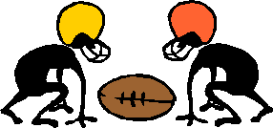
2. Face-to-Face Interaction (promote each other's success)
Orally explaining how to solve problems
Teaching one's knowledge to other
Checking for understanding
Discussing concepts being learned
Connecting present with past learning

Slide 16
3. Individual &Group Accountability
Keeping the size of the group small. The smaller the size of the group, the greater the individual accountability may be.
Giving an individual test to each student.
Randomly examining students orally by calling on one student to present his or her group's work to the teacher (in the presence of the group) or to the entire class.
Observing each group and recording the frequency with which each member-contributes to the group's work.
Assigning one student in each group the role of checker. The checker asks other group members to explain the reasoning and rationale underlying group answers.
Having students teach what they learned to someone else.

Slide 17
4. Interpersonal (social) &Small-Group Skills
Social skills must be taught in order to successful cooperative learning to occur:
Decision-making
Trust-building
Leadership
Communication
Conflict-management skills

Slide 18
5. Group Processing
Group members discuss how well they are achieving their goals and maintaining effective working relationships
Describe what member actions are helpful and not helpful
Make decisions about what behaviors to continue or change.

Slide 19
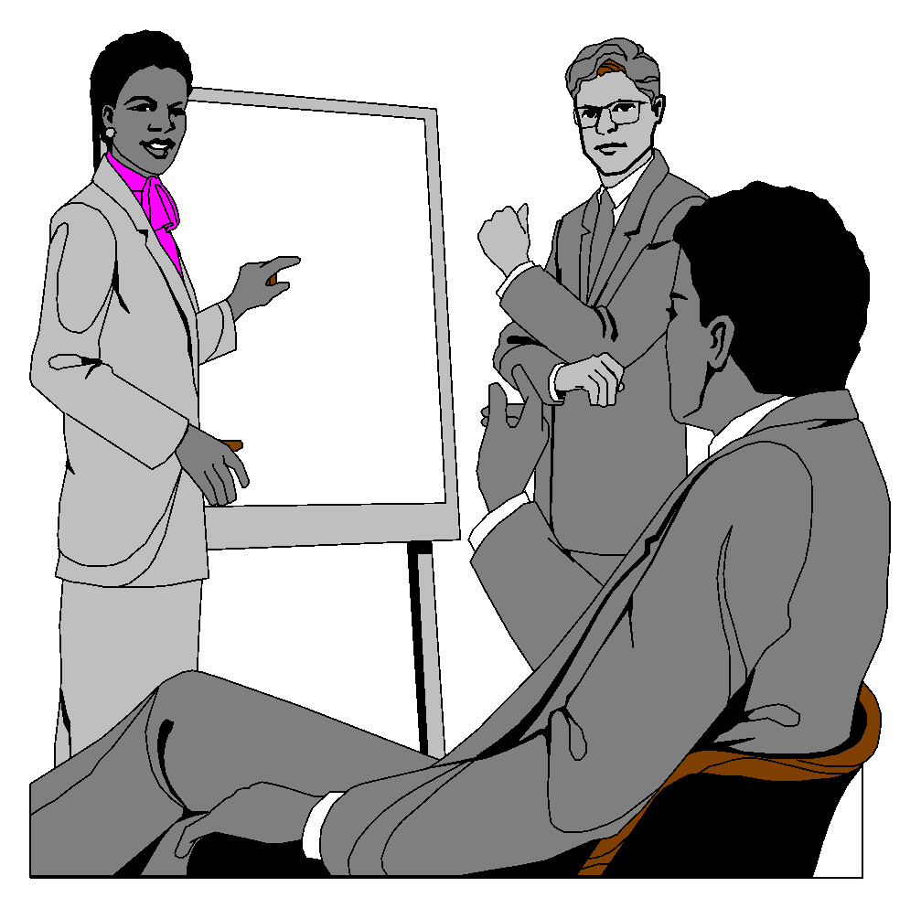
Roles are assigned in a cooperative group.
LEADER
RECORDER
CHECKER
Timer
OBSERVER

Slide 20
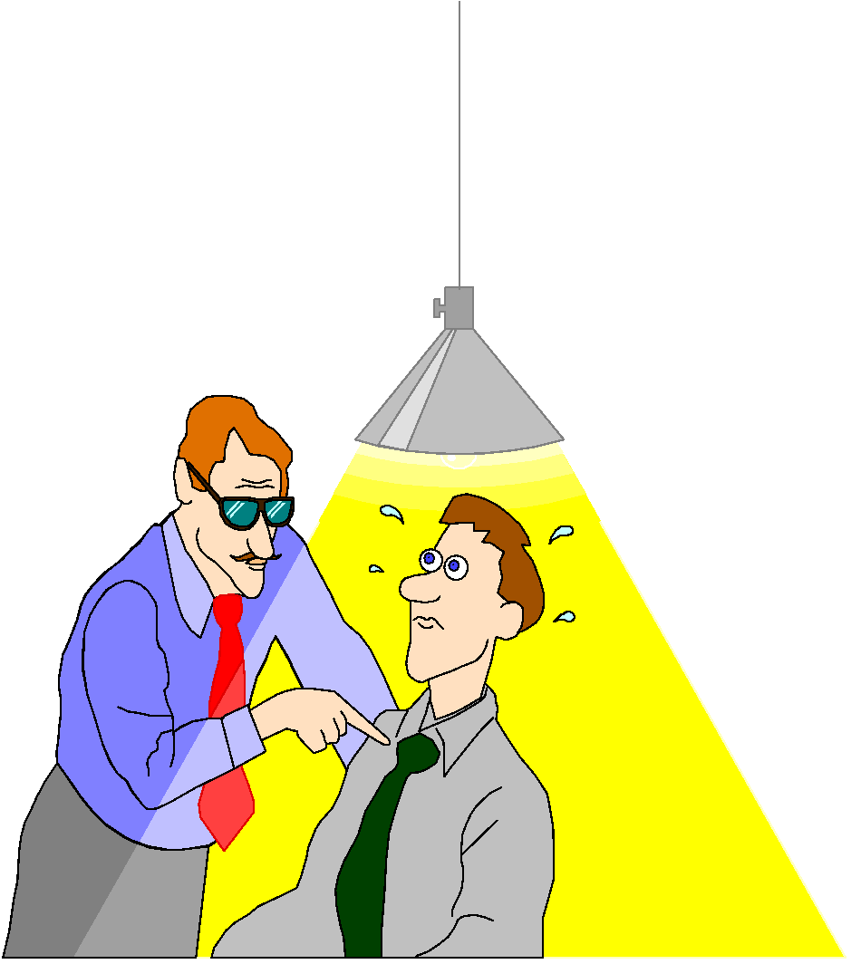
CHECKER
-makes sure that everyone in the group understands all the material
-ensures that everyone in the group is prepared to make their part of the presentation.

Slide 21
LEADER
-responsible for the groups output
-keeps group ‘on track’ and focused
-assigns tasks
-controls the direction of the project
-assigns additional roles, such as ‘experimenter’ or ‘equipment manager’

Slide 22
RECORDER
-takes notes for the team
-responsible for compiling and presentation of final product
-gets supplies for team when necessary

Slide 23
OBSERVER/READER
-makes sure that everyone in the group is contributing (no sponges!)
-ensures that everyone in the group has an equal opportunity to speak.
-makes sure that all comments are positive.
-reads material to the group.

Slide 24
Types of CL
Formal CL is structured, facilitated and monitored by the educator over time and is used to achieve group goals in task.
JIGSAW
Assignment that involve group problem solving and decision making
Laboratory assignment

Slide 25
Formal CL
Formal groups-
-Designed for students to have enough time to
thoroughly complete an academic assignment
-May last several days or weeks.
-Design tasks to include:
Positive interdependence
Group processing
Face to face promotive interaction
Individual and group accountability
Social and Interpersonal Skills

Slide 26
Informal CL
Informal CL incorporate group learning with passive teaching by drawing attention to material through small groups throughout the lesson or by discussion at the end of lesson and typically involves group of two (Eg turn to your partner discussion)facilitated and monitored by the educator over time and is used to achieve group goals in task.
Eg Think-pair-share

Slide 27
Informal CL
Informal groups:
They are temporary groups that last for only one discussion or one class period. Their purposes are to focus student’s attention on the material to be learned, set a mood conducive to learning, help organize in advance the material to be covered in a class session, ensure that students cognitively process the material being taught, and provide closure to an instructional session. They may be used at any time, but are especially useful during a lecture or direct teaching ,Can last a few minutes or class period .
Examples:
A-Summarize the answer to the question being discussed. b. Solve a problem. c. Give a reaction to a theory, a concept, or information being presented. d. Elaborate (relate material to past learning so that it gets integrated into existing conceptual frameworks) the material being presented. e. Predict or explain. f. Attempt to resolve the conceptual conflict the presentation has aroused. g. Hypothesize answers to the question being posed.

Slide 28
Types
Based group learning(eg long term study group):
Is effective for learning complex subject matter over the course, term or semester and established caring, supportive peer relationships, which in turn motivates and strengthens the student’s commitment to the group’s education while increasing self-esteem and self-worth.
Based group approaches also make the students accountable to educating their peer group in the event that a member was absent for a lesson. This is effective both individual learning as well as social support.

Slide 29
Base groups
Created to provide students support throughout a semester or academic year
Results: general sense of belonging to class
The base group functions as a support group for its members that:
Gives assistance, support, and encouragement for mastering the course content and skills and provides feedback on how well the content and skills are being learned.
Gives assistance, support, and encouragement for thinking critically about the course content, explaining precisely what one learns, engaging in intellectual controversy, getting the work done on time, and applying what is learned to one's own life.
Provides a set of interpersonal relationships to personalize the course and to try out the cooperative learning procedures and skills emphasized within the course.
Provides a structure for managing course evaluation

Slide 30
Cooperative learning techniques
Think-pair-share
Jigsaw
Jigsaw II
Reverse Jigsaw
Inside-outside circle
etc

Slide 31
More Examples of cooperative learning
Peer tutoring, Conversation cards, Think-pair-share, Role-plays
Jigsaw, Open-ended free conversations , Information-gap activities, Problem solving, Storytelling, Cooperative projects,
Paired interviews, Sharing opinions, debating, narrating, describing, and explaining.

Slide 32
Why use Cooperative Learning in classes?

Slide 33
The more students work in cooperative learning groups:
The more they will learn
The better they will understand what they are learning
The easier it will be to remember what they learn
The better they will feel about themselves, the class and their classmates.
Other outcomes
Positive relationships, and psychological health.
Higher achievement and greater productivity
More caring, supportive, and committed relationships
Greater psychological health, social competence, and self esteem.
Acknowledgment of individual differences
Interpersonal development
Active involvement in learning
More opportunities for personal feedback

Slide 34
Deeper understanding of content
Increased overall achievement in grades
Improved self-esteem
Higher motivation to remain on task
Active and constructive involvement in content
Ownership of their own learning
Solving group conflicts
Improvement of teamwork skills
Increased student retention
Enhancement of student satisfaction with their learning experience
Development of skills in oral communication
Development of students' social skills

Slide 35
Jigsaw
The cooperative learning strategy known as the "jigsaw" technique helps students create their own learning. Teachers arrange students in groups. Each group member is assigned a different piece of information. Group members then join with members of other groups assigned the same piece of information, and research and/or share ideas about the information. Eventually, students return to their original groups to try to "piece together" a clear picture of the topic at hand. That's the simple overview. The resources below will fill in the details and provide examples of the technique in action.

Slide 36
Jigsaw
The jigsaw classroom is a research-based cooperative learning technique invented and developed in the early 1970s by Elliot Aronson and his students at the University of Texas and the University of California. Since 1971, thousands of classrooms have used jigsaw with great success.
The Jigsaw Classroom is a cooperative learning technique that reduces racial conflict among school children, promotes better learning, improves student motivation, and increases enjoyment of the learning experience.

Slide 37
Jigsaw classroom in 10 Easy Steps:
Divide students into 5- or 6-person jigsaw groups (home groups). The groups should be diverse in terms of gender, ethnicity, race, and ability.
Appoint one student from each group as the leader.
Divide the day's lesson into 5-6 segments. For example, if you want ICT students to learn about Computer evolution,
Then, students will move from jigsaw groups (home groups) to expert groups, depending on the segment they work.
Students spend time to read over their segment at least twice and become familiar with it.

Slide 38
Jigsaw classroom in 10 Easy Steps:
Give students in these expert groups time to discuss the main points of their segment and to rehearse the presentations they will make to their jigsaw group (home group).
Bring the students back into their jigsaw groups.
Ask each student to present her or his segment to the group.
Encourage others in the group to ask questions for clarification.
Each home group make a presentation about the topic.

Slide 39
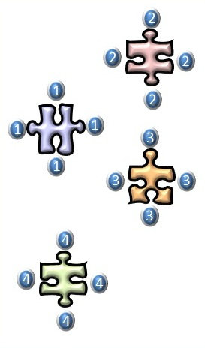
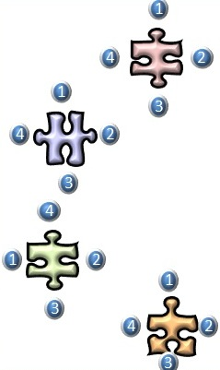

Slide 40
Questions
Q & A

